Slide 1
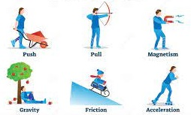
ljifo M lj1fg tyf k|ljlw
(Science & Technology)
sIff M ( PsfO{ M &
an / rfn
(Force and Motion)
l8hL6n k7g tyf kf7g ;fdu|L
sfo{306f M !!

Slide 2
of] PsfO{df xfdLx? lgDglnlvt ljifoj:t'x? af/] cWoog ug{]5f}F .
&=! l;wf/]vLo rfnsf ;dLs/0fx¿
&=@ l;wf/]vLo rfnsf u|fkm
:yfgfGt/0f–;dosf] u|fkm
ult—;dosf] u|fkm
ult / k|j]u ;DalGw ul0ftLo ;d:ofx¿
&=# rfn;DaGwL Go'6gsf lgodx¿
Ogl;{of
rfn;DaGwL Go'6gsf] klxnf] lgod / b}lgs hLjgdf pkof]usf pbfx/0fx¿
rfn;DaGwL Go'6gsf] bf];|f] lgod / o;;DaGwL ul0ftLo ;d:of
rfn;DaGwL Go'6gsf] t];|f] lgod / b}lgs pkof]ux¿sf pbfx/0fx¿
lj|mof / k|ltlj|mofsf hf]8Lx¿
&=$ Onfl:6l;6L / Knfl:6l;6L
kl/efiff / pbfx/0f

Slide 3
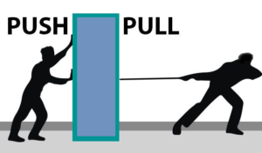
anM an eg]sf] Pp6f aflx/L tTj xf] h;n] l:y/ cj:yfdf
/x]sf] j:t'nfO{ rfn / rfn cj:yfdf /x]sf] j:t'nfO{ l:y/
cj:yfdf Nofp5 cyjf Nofpg vf]H5 .
ansf] P; cfO{ PsfO{ Go'6g(N) / l; hL P; PsfO{ Dyne
xf] . 1 Newton = 10⁵ Dyne

Slide 4
a]u / ult -Speed and Velocity_
a:t'n] k|lt PsfO{ ;dodf kf/ ug]{ b'/LnfO{ a]u elgG5 .
a]u :s]n/ kl/df0f xf] .
j:t'n] lglZrt lbzflt/ k|ltPsfO ;dodf\ kf/ u/]sf] b'/L pSt j:t'sf] ult -Velocity_ xf] .
ult e]S6/ kl/df0f xf] .
a]u / ultsf] PsfO{ m/s

Slide 5
j:t'n] k|lt;]s]G8df kf/ ug]{ b'/L ult xf] .
c;dfg ultn] lglZrt lbzfdf u'l8/x]sf] j:t'n] nIodf k'Ubf To;n] kf/ u/]sf] hDdf b'/LnfO{ pSt b'/L kf/
ug{ nfu]sf] ;don] efu ubf{ k|fKt x'g] ult Tof] j:t'sf] cf};t ult x'G5 .
ultsf] dfgdf kl/jt{g geP/ s]jn lbzf kl/jt{g x'Fbf ult kl/jt{g x'G5 t/ j]u l:y/ /xG5 .
lrq 7.5 df b]vfOP h:t} ;Gbe{ laGb' -reference point_ sf cfwf/df s'g} Ps lbzfdf uO/x]sf] j:t'n] l7s ljk/Lt lbzfdf hfFbf ult wgfTdsaf6 C0ffTds x'G5 . j:t'sf] j]u ;w} wgfTds x'G5 .

Slide 6
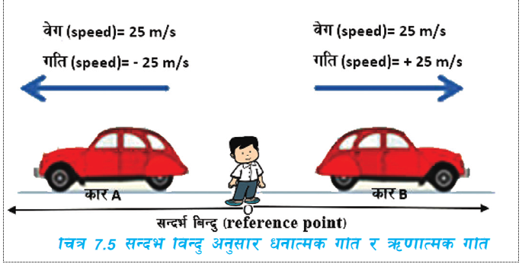

Slide 7
k|j]u Acceleration
k|lt PsfO ;dodf x'g] ult kl/jt{gnfO{ k|j]u elgG5 . o;sf] SI PsfO m/s² xf] .
k|j]u (a) = clGtd ult (v) – ;'?sf] ult (u)
;do (t)
k[YjLsf] u'?Tjansf] sf/0f :jtGq ¿kdf vl;/x]sf] j:t'df pTkGg x'g] k|j]u u'?Tj k|j]u xf] . o;nfO 'g' n] ;ª\s]t ul/G5 .
k[YjLsf] ;txdf o;sf] cf};t dfg 9.8 m/s² x'G5 .
u'8\b} u/]sf] a;df lj:tf/} a|]s nufpFbf o;sf] ult 36\b} u/]sf] cg'ej ug{ ;lsG5 .
s'g} rfn cj:yfdf /x]sf] j:t'sf] k|ltPsfO ;dodf ult 36\g] b/nfO{ ultx|f; -retardation_ elgG5 . o;nfO{ C0ffTds k|j]u elgG5 .

Slide 8
:jtGq ¿kn] vl;/x]sf] j:t'sf] rfnsf] lbzf lglZrt eP tfklg k|lt ;]s]G8 kf/ ug]{ b'/L km/s
km/s x'G5 h'g c;dfg ult xf] .
vl;/x]sf] j:t'n] kf/ u/]sf] hDdf b'/LnfO{ nfu]sf] ;don] efu ubf{ cf};t ult k|fKt x'G5 . :jtGq v;fOsf] cj:yfdf j:t'sf] k|j]u eg] k|lt ;s]G8 ;dfg x'G5 . j:t' ;dfg k|j]un] l;wf /]vfdf v:bf jf u'8\bf j:t'sf] k|f/lDes ult / clGtd ultsf] dWosn] pSt j:t'sf] cf};t ult lbG5 .
l;wf /]vLo rfndf ;dfg k|j]un] ePsf] j:t'sf nflu
cf};t ult (Vav) = ;'?sf] ult -u_ ± clGtd ult -v_
2

Slide 9
l;wf /]vLo rfnsf ;dLs/0fx¿ -Equations of linear motion)
l;wf /]vLo rfnsf ;dLs/0fdf ;dfj]z r/ /flzx¿ s, u, v, a, t cGt{ut l;wf /]vLo rfndf
/x]sf] j:t'sf nflu 'u' n] pSt j:t'sf] ;'?sf] ult, 'v' n] j:t'sf] clGtd ult, 'a' j:t'df pTkGg k|j]u, 't' n] j:t' rfn cj:yfdf x'Fbfsf] ;do / 's' j:t' rfndf x'Fbf ;'?sf] :yfgaf6
ePsf] :yfgfGt/0fnfO{ hgfpF5g\ .
1. l;wf /]vLo rfnsf nflu ;'?sf] ult 'u' clGtd ult 'v' ,k|j]u 'a' / ;do 't' ;DaGwL ;dLs/0f
dfgf}F, s'g} l;wf /]vLo rfndf /x]sf] j:t'sf] ;'?sf] ult 'u' Psgf;n] kl/jt{g x'Fb} s]xL ;do 't' kl5 clGtd ult 'v' df kl/0ft eof] .
k|j]usf] kl/efiffcg';f/, k|j]u = clGtd ult – ;'?sf] ult
;do
a = (v-u)
t
at = v - u
v = u + at ………………….. (i)

Slide 10
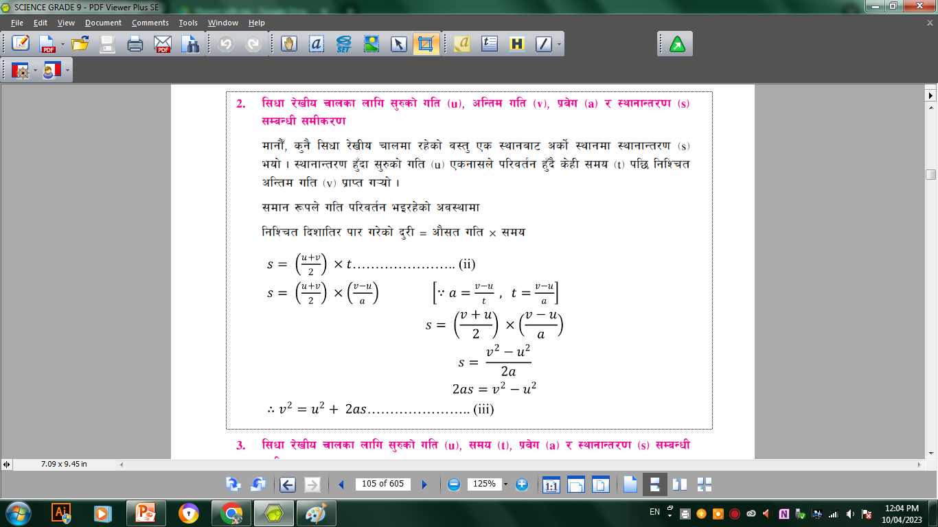
k|f/lDes :yfgaf6 lglZrt lbzfdf uP/ clGtd :yfgdf k'Ubf j:t'n] kf/ u/]sf] ;a}eGbf 5f]6f] b'/L :yfgfGt/0f (displacement) xf] . :yfgfGt/0fnfO{ JoSt ubf{ dfg;u} lbzf klg pNn]v ul/g] ePsfn] of] Ps e]S6/ kl/df0f xf] .

Slide 11
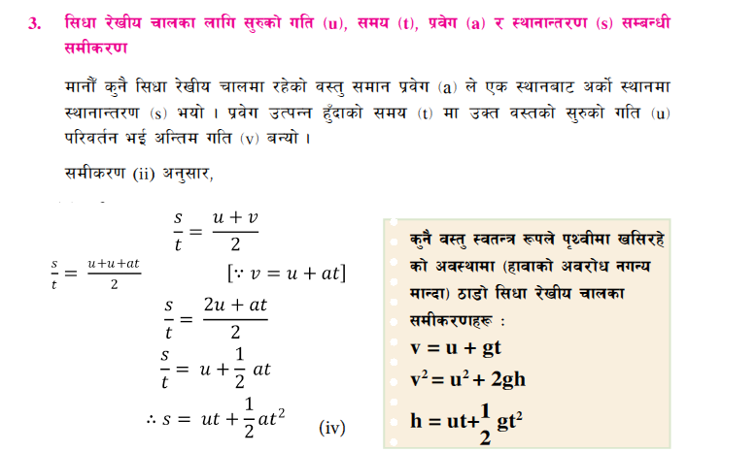

Slide 12
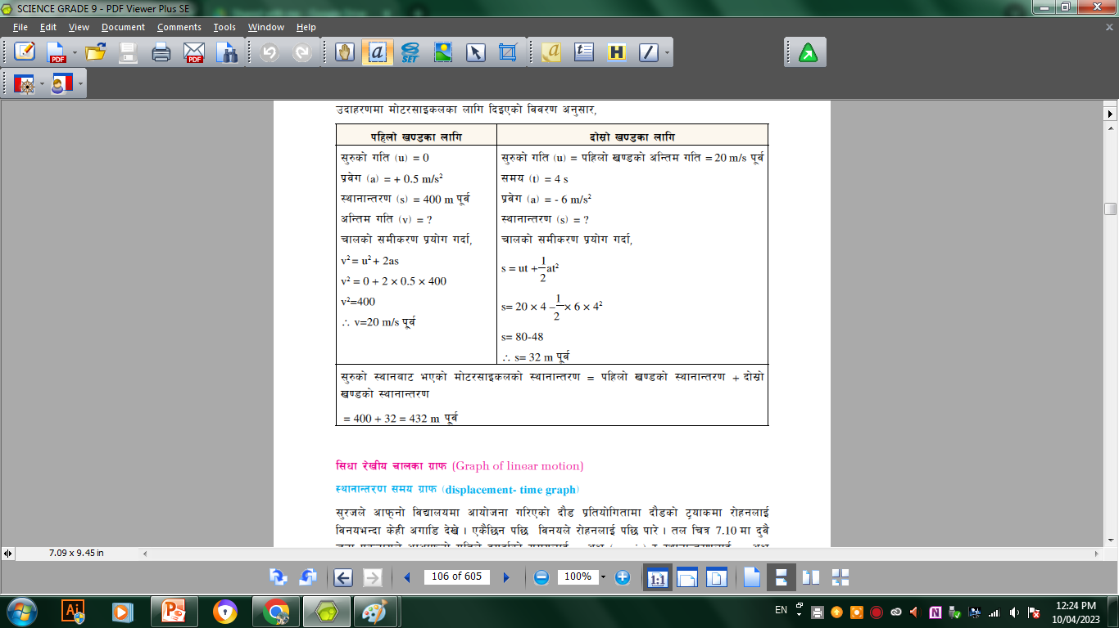
Equation of linear motion df cfwfl/t ul0ftLo ;Df:of / ;dfwfg
k"j{ klZrd /fhdfu{sf] l;wf v08df Pp6f l:y/ cj:yfaf6 rNg ;'? u/]sf] df]6/;fOsn 0.5 m/s2 sf] ;dfg k|j]un] 400 m k"j{lt/ u'l8;s]kl5 rfnsn] a|]ssf] k|of]u u/] . pSt df]6/;fOsnsf] ult 4 s ;Dd Psgf;n] 36\b} 6 m/s2 sf] ultx|f; pTkGg eof] . ;'?sf] :yfgaf6 ePsf] df]6/;fOsnsf] :yfgfGt/0f lx;fa ug'{xf];\ M

Slide 13
ul0ftLo ;d:ofx¿
-!_ l:y/ cj:yfaf6 wfjg dfu{df blIf0f lbzf tk{m u'8\g ;'? u/]sf] xjfOhxfhdf 1.5 m/s2
sf] ;dfg k|j]u pTkGg eof] / 30 s kl5 hldgaf6 p8\of] . xjfOhxfh wfjgdfu{df u'8\bf
;'?sf] :yfgaf6 clGtd :yfg ;Ddsf] :yfgfGt/0f / l7s hldgaf6 p8\g' k"j{sf] ult
lx;fa ug'{xf];\ . (675 m blIf0f, 45 m/s blIf0f_
-@_ /f]xgn] Pp6f k'nsf] dfly af6 gbLsf] kfgLdf 9'ª\uf v;fn] / ;'/hn] tn glbsf] 5]pdf a;L :6kjfrsf] ;xoftfn] 9'ª\ufnfO{ kfgLsf] ;tx;Dd cfOk'Ug nfu]sf] ;do 2 s kQf nufP . 9'ª\ufsf] v;fOdf k|j]unfO{ 9.8 m/s2 dfgL kfgLsf] ;txaf6 k'nsf] prfO lx;fa ug'{xf];\ | (19.6 m)

Slide 14
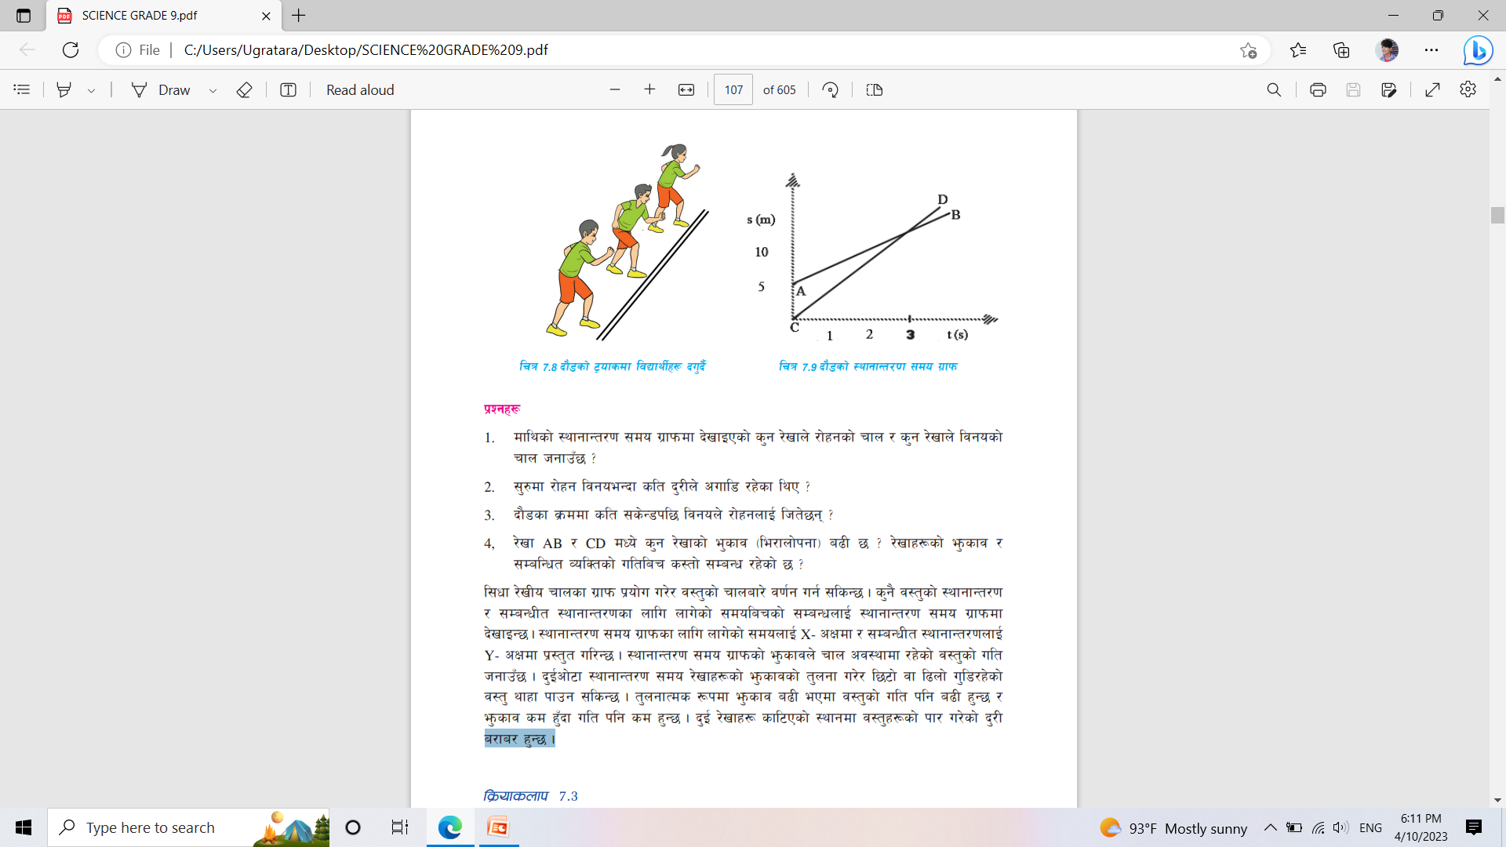
l;wf /]vLo rfnsf u|fkm (Graph of linear motion)M
:yfgfGt/0f ;do u|fkm -displacement- time graph_ M :yfgfGt/0f ;do u|fkmsf nflu nfu]sf] ;donfO{ X- cIfdf / ;DaGwLt :yfgfGt/0fnfO Y- cIfdf k|:t't ul/G5 . :yfgfGt/0f ;do u|fkmsf] e'msfjn] rfn cj:yfdf /x]sf] j:t'sf] ult hgfpF5 .
b'O{cf]6f :yfgfGt/0f ;do /]vfx¿sf] e'msfjsf] t'ngf u/]/ l56f] jf l9nf] u'l8/x]sf] j:t' yfxf kfpg ;lsG5 . t'ngfTds ¿kdf e'msfj a9L ePdf j:t'sf] ult klg a9L x'G5 / e'msfj sd x'Fbf ult klg sd x'G5 .
b'O{ /]vfx¿ sfl6Psf] :yfgdf j:t'x¿sf] kf/u/]sf] b'/L a/fa/ x'G5 .

Slide 15
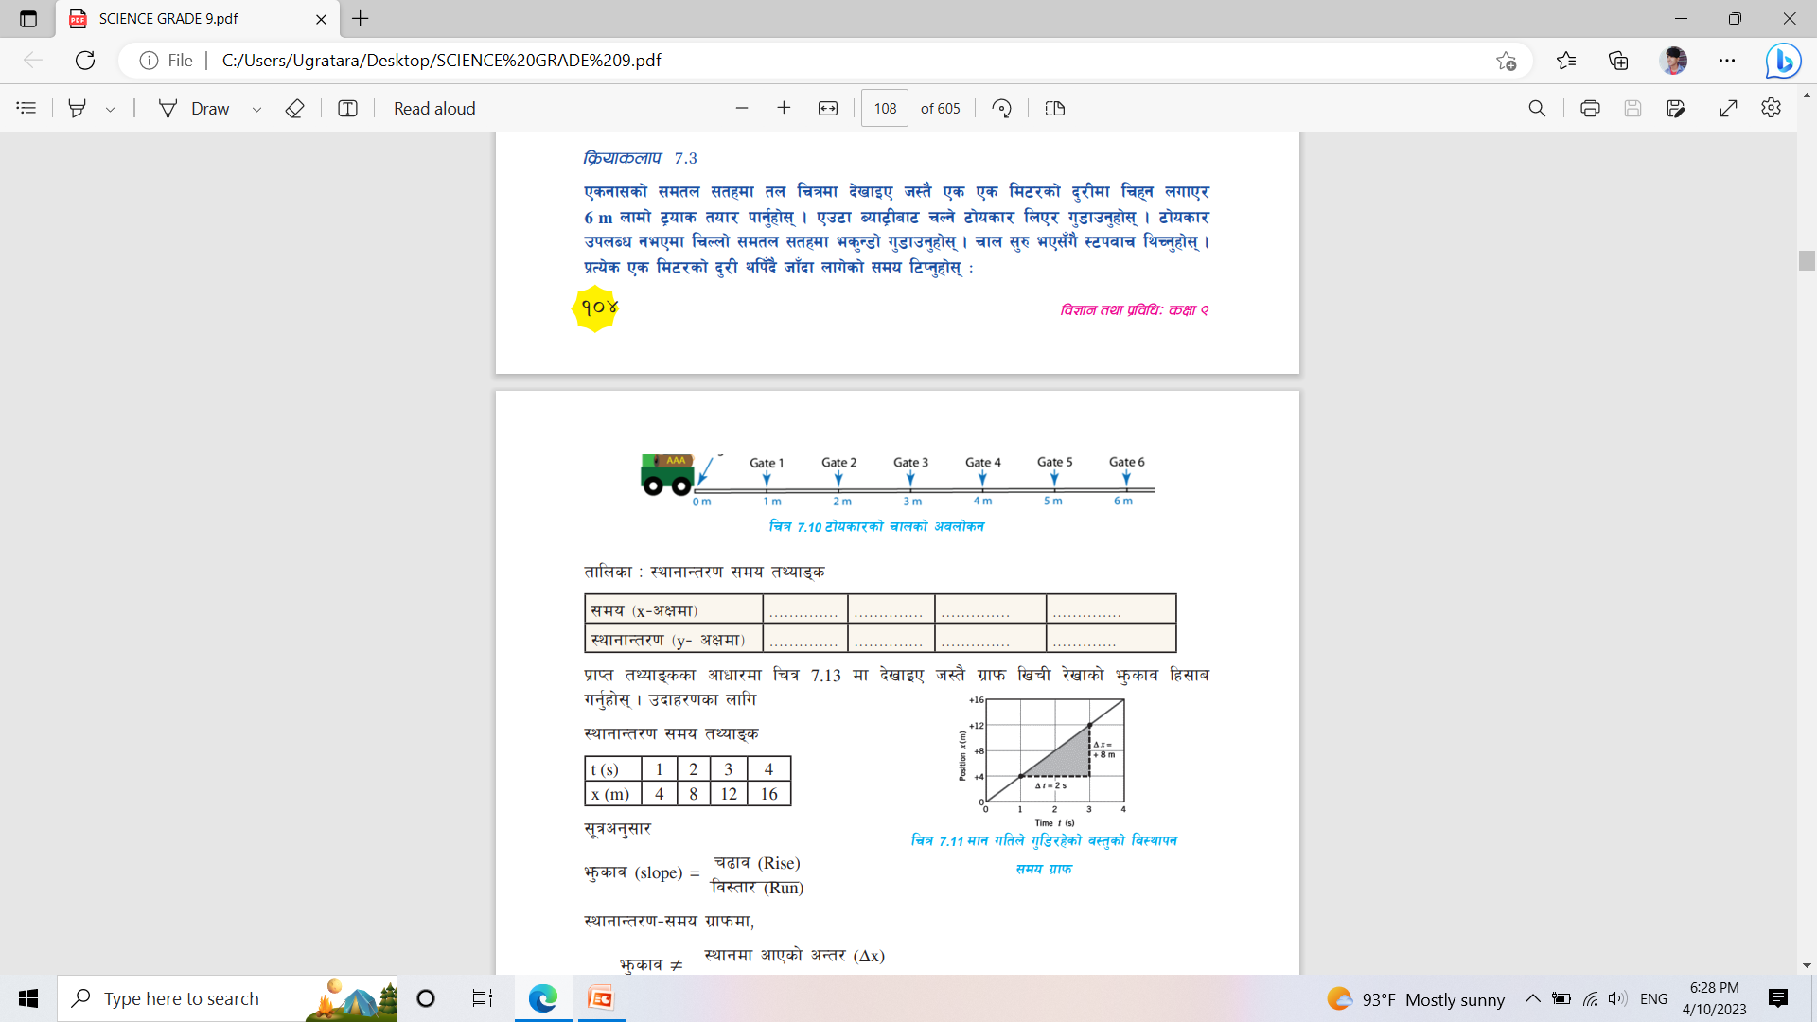
lj|mofsnfk M Psgf;sf] ;dtn ;txdf tn lrqdf b]vfOP h:t} Ps Ps ld6/sf] b'/Ldf lrx\g nufP/ 6 m nfdf] 6«ofs tof/ kfg'{xf];\ . Pp6f Aof6«Laf6 rNg] 6f]osf/ lnP/ u'8fpg'xf];\ . 6f]osf/ pknAw gePdf lrNnf] ;dtn ;txdf es'G8f] u'8fpg'xf];\ . rfn ;'? eP;“u} :6kjfr lyRg'xf];\ . k|To]s Ps ld6/sf] b'/L ylk“b} hf“bf nfu]sf] ;do l6Kg'xf];\ M
:yfgfGt/0f ;do tYofª\s
;do -x–cIfdf_ | 1 | 2 | 3 | 4
:yfgfGt/0f -y– cIfdf_ | 4 | 8 | 12 | 16

Slide 16
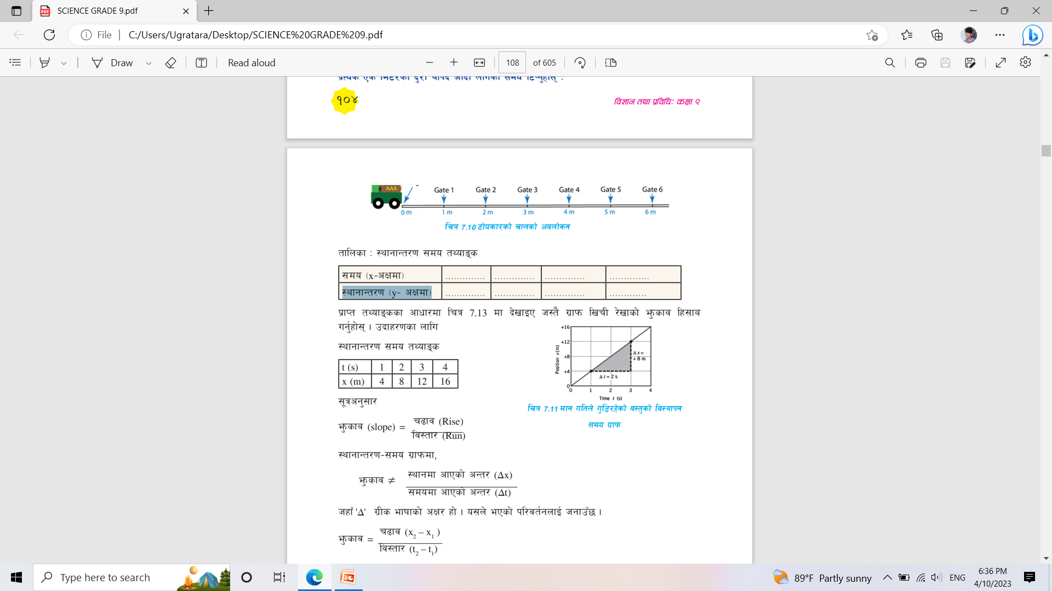
;"qcg';f/
e'msfj (slope) = r9fj (Rise)
lj:tf/ (Run)
:yfgfGt/0f–;do u|fkmdf,
e'msfj = :yfgdf cfPsf] cGt/ (∆x)
;dodf cfPsf] cGt/ (∆t)
hxfF '∆’ u|Ls efiffsf] cIf/ xf] . o;n] ePsf] kl/jt{gnfO{ hgfpF5 .
e'msfj = r9fj (x2 – x1 )
lj:tf/ (t2 – t1 )
e'msfj = 8/2 = 4 m/s

Slide 17
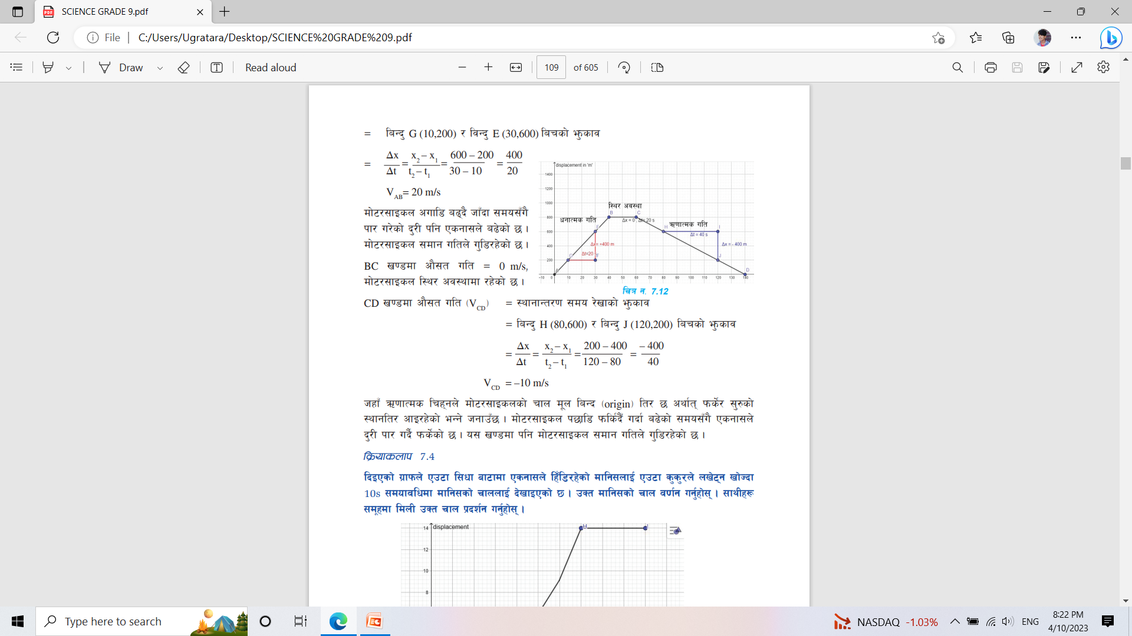
pbfx/0fsf] NffUfL
tnsf] u|fkmdf Pp6f df]6/;fOsnsf] rfnnfO{ tLgcf]6f v08df b]vfOPsf] 5 . pSt v08x¿df df]6/;fOsnsf] cf};t ult / ultsf] cj:yf klg n]Vg'xf];\ M

Slide 18
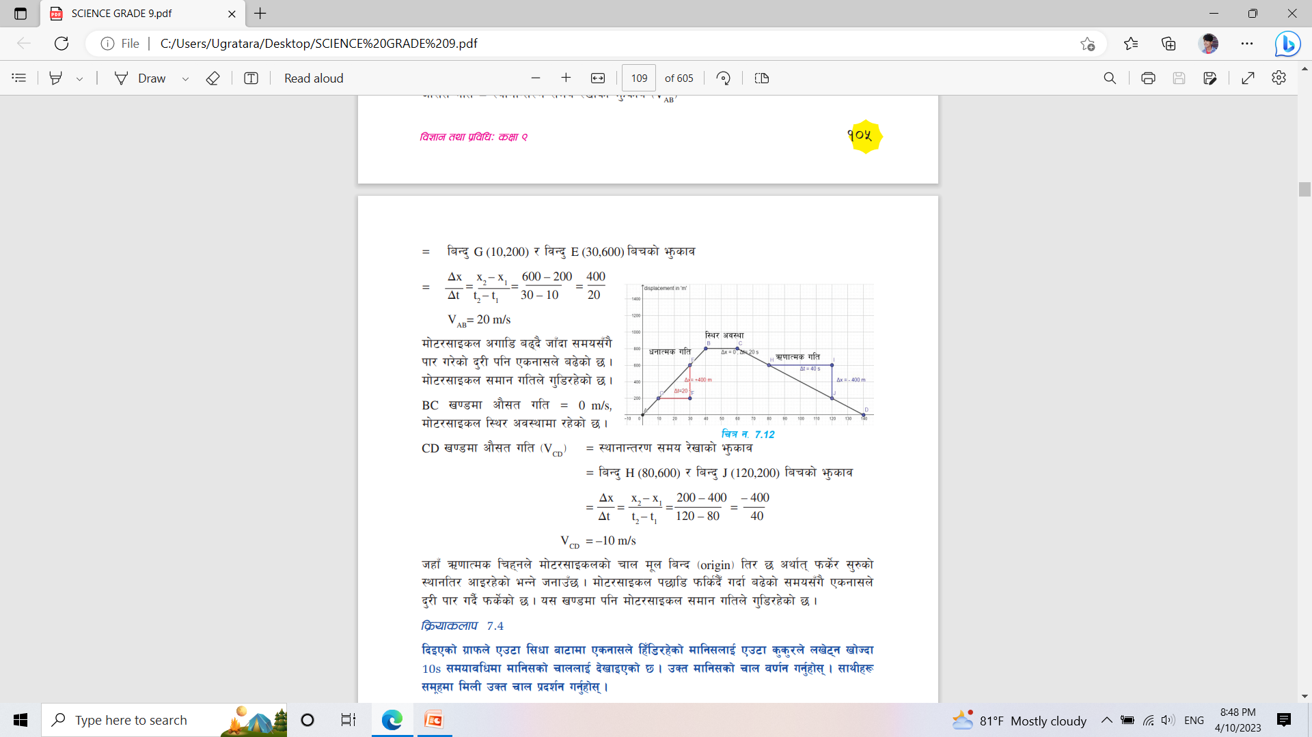
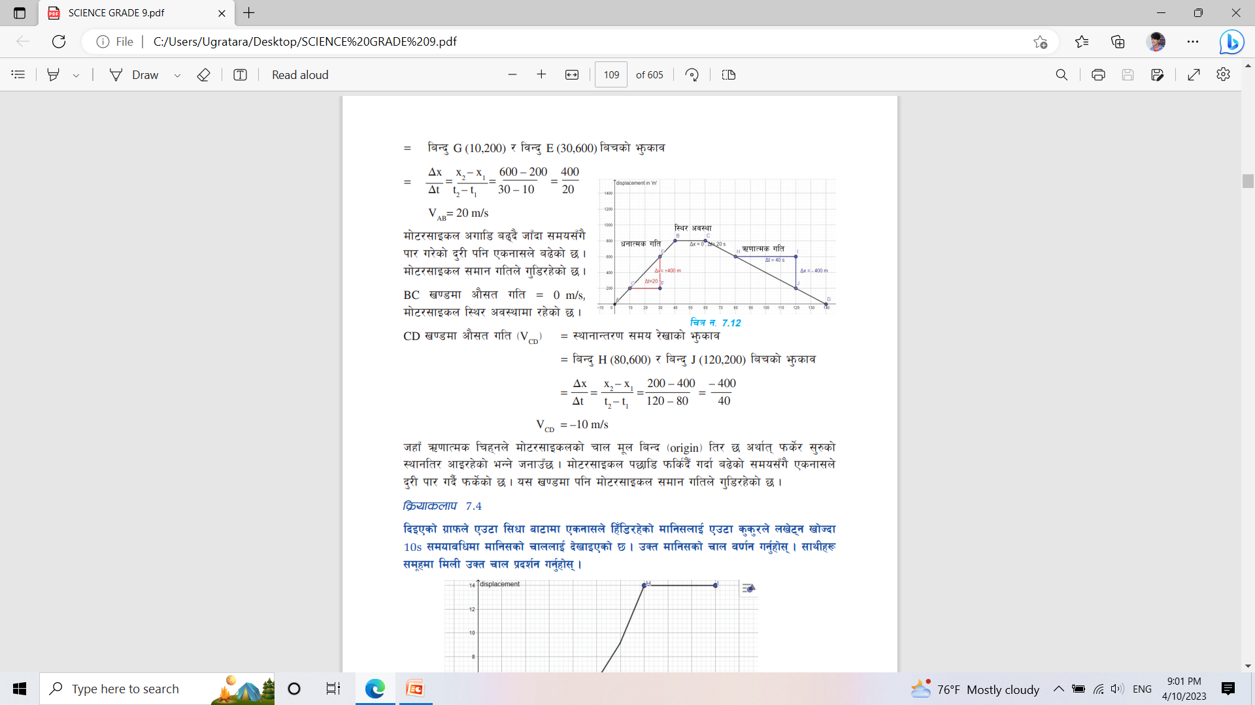
u|fkmcg';f/, AB v08df cf};t ult :yfgfGt/0f ;do /]vfsf] e'msfj (V_{AB})
= laGb' G (10,200) / ljGb' E (30,600) larsf] e'msfj
+
BC v08df cf};t ult = 0 m/s,
df]6/;fOsn l:y/ cj:yfdf /x]sf] 5 .
CD v08df cf};t ult -V_{CD}_ = :yfgfGt/0f ;do /]vfsf] e'msfj
laGb' H (80,600) / laGb' J (120,200) larsf] e'msfj
hxfF C0ffTds lrx\gn] df]6/;fOsnsf] rfn d"n laGb -origin_ lt/ 5 cyf{t\ kms]{/ ;'?sf] :yfglt/ cfO/x]sf] eGg] hgfpF5 . df]6/;fOsn k5fl8 kmls{b}F ubf{ a9]sf] ;do;Fu} Psgf;n] b'/L kf/ ub{} kms]{sf] 5 . o; v08df klg df]6/;fOsn ;dfg ultn] u'l8/x]sf] 5

Slide 19
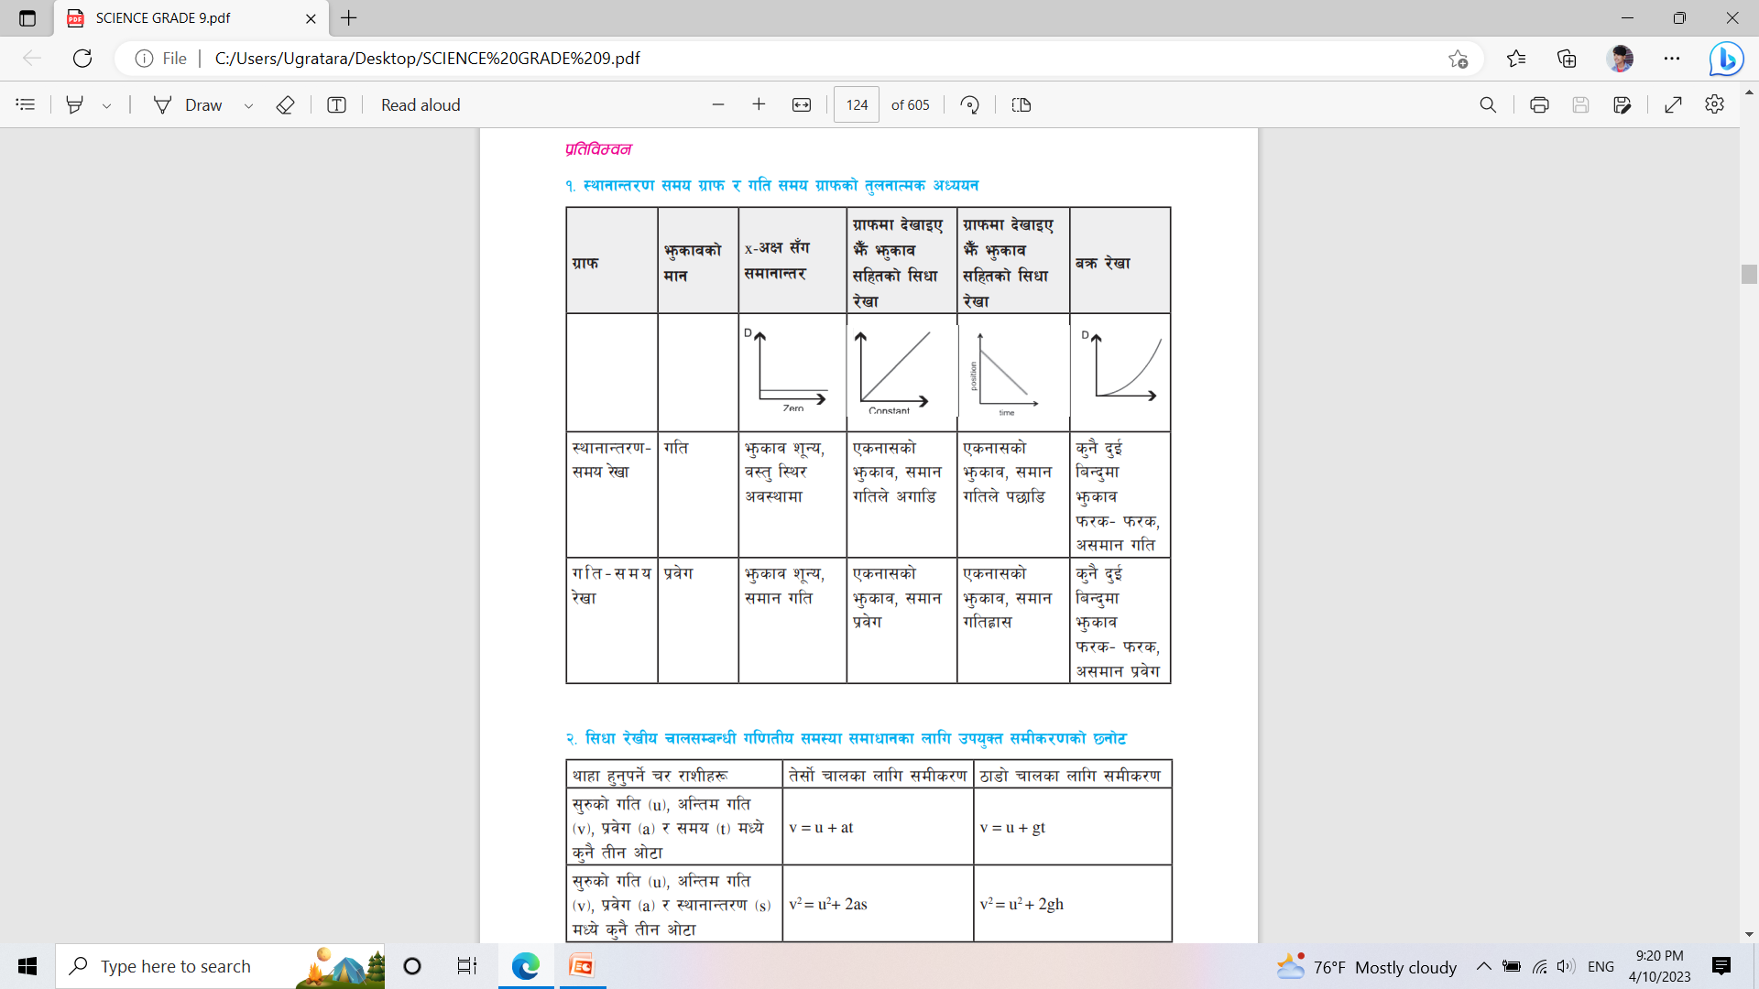
ult – ;do u|fkm (velocity- time graph) / :yfgfGt/0f ;do u|fkm -displacement- time graph_ ljr tngf

Slide 20
rfn;DaGwL Go'6gsf lgodx¿ -Newton's laws of motion_
;/ cfOHofs Go"6g -Sir Issac Newton_ Ps ef}ltszf:qL / ul0ft1 lyP .
pgn] ;g\ 1687 df j:t'sf] rfn;DaGwL tLgcf]6f lgodx¿ k|ltkfbg u/]sf lyP .
Go'6gsf] rfn;DaGwL klxnf] lgodn] an / Ogl;{ofsf] kl/efiff lbG5 .
bf];|f] lgodn] ansf] k|of]u / j:t'sf] lk08;Fu k|j]usf] ;DaGwsf] j0f{g ub{5 . o;sf] k|of]uaf6 ansf] dfkg ug{ ;lsG5 .
Go"6gsf] t];|f] lgodn] b'O{ anx¿ lj|mof -action_ / k|ltlj|mof -reaction_ larsf] ;DaGw :yflkt ub{5 . o;n] ansf] u'0f atfpF5 .

Slide 21
Ogl;{of -Inertia)
l:y/ cj:yfdf /x]sf] j:t' l:y/ cj:yfd} /xg vf]H5 / rfn cj:yfdf /x]sf] j:t' ;dfg ultn] pxL lbzfdf rfndf /xg vf]Hg] u'0fnfO{ Ogl;{of elgG5 .
jf s'g} klg j:t'n] o;sf] cj:yfdf ug{ vf]lhg] kl/jt{gsf] cj/f]w u/L oyfl:yltdf /lx/xg vf]Hg] u'0fnfO{ Ogl;{of elgG5 .
Examples:
lkª v]Ng] qmddf o;nfO{ dRrfpg / dRrfP/ 5f]8]sf] lkª l:y/ cj:yfdf cfpg s]xL ;do nfU5 .
l:jr cg ug]{ ljlQs} ljB't\ kª\vf hf]8n] 3'Db}g / 3'ld/x]sf] kª\vfsf] l:jr ckm ug]{ lalQs} /f]lsb}g

Slide 22
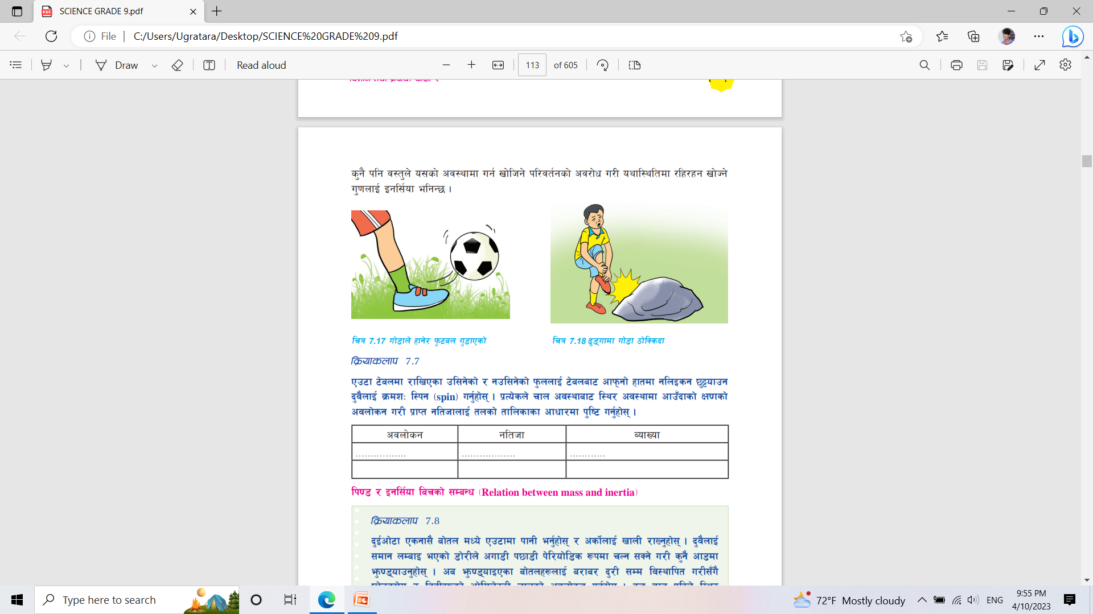
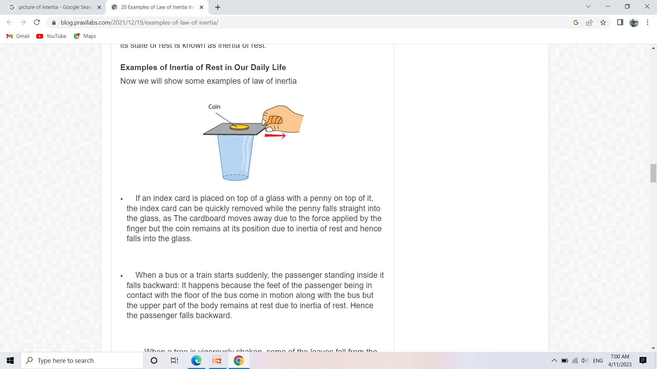

Slide 23
lk08 / Ogl;{of larsf] ;DaGw -Relation between mass and inertia_
sd lk08 ePsf] tyf a9L lk08 ePsf] b'j} j:t' oyfl:yltdf /xg vf]H5g\ .
tL j:t'x¿df afx\o ansf] cj/f]w ug]{ Ifdtf eg] km/s–km/s x'G5 .
j:t'df x'g] Ogl;{of o;sf] lk08df lge{/ x'G5 .
j:t'sf] lk08 a9\bf Ogl;{of klg a9\5 / lk08 36\bf Ogl;{of klg 36\5 .

Slide 24
l:y/ Ogl;{of -Inertia of rest_
s'g} l:y/ cj:yfdf /x]sf] j:t'sf] l:y/ cj:yfd} /lx/xg vf]Hg] u'0f l:y/ Ogl;{of xf] .
tn l:y/ Ogl;{ofsf yk pbfx/0fx¿ k|:t't ul/Psf 5g\ .
i. k|of]udf /x]sf] sfk]{6df lxsf{pFbf o;df ePsf] w'nf] em5{ .
ii. l:y/ cj:yfdf /x]sf] ;jf/L ;fwg h:t} a;nfO{ PSsf;L rfndf NofpFbf ofq'x¿sf] z/L/ k5fl8 lt/ x'lQG5 .
iii. ?vdf cfFk kmn]sf] cj:yfdf o;sf] xfFuf xNnfpFbf cfFk v:5g\ .
iv. Sof/d v]Nbf uf]6Lx¿sf] rfªdf l:6fOs/n] hf]8n] lxsf{Pdf s]an lkFwsf] uf]6L lg:sG5 / afFsL rfFª g9nLsg a:5 .
dflysf pbfx/0fx¿df c;Gt'lnt ansf] c;/n] j:t' jf o;sf] efu l:y/ cj:yfaf6 rfn cj:yfdf cfpFbf pSt kl/jt{gsf] cj/f]w ePsf] 5 . pbfx/0fsf nflu a; PSsf;L rfndf cfpFbf To; leq /x]sf ofq'x¿sf] z/L/sf] dflyNnf] efu l:y/ cj:yfd} /xg vf]H5 t/ a;sf] ;Dks{df /x]sf] z/L/sf] tNnf] efu eg] a;;Fu} rfndf cfpF5 . h;n] ubf{ ofq'x¿ k5fl8lt/ x'lQG5g\

Slide 25
rfn Ogl;{of -Inertia of motion)
rfn cj:yfdf /x]sf] j:t'sf] ;dfg ultn] pxL lbzfdf rfn cj:yfd} /lx/xg vf]Hg] u'0f rfn Ogl;{of xf] .
tn rfn Ogl;{ofsf pbfx/0fx¿ k|:t't ul/Psf 5g\ .
i. rfnsn u'l8/x]sf] ;fOsnsf] k]8ndf an gnufpFbf klg s]xL ;do;Dd u'l8]/xG5 .
ii. u'l8/x]sf ;jf/L ;fwgx¿ h:t} a;df PSsfl; a|]s nufpFbf o;df ePsf ofq'x¿sf] z/L/ cufl8lt/ x'lQG5 .
iii. 8«fOe/n] 3'DtLx¿df a; PSsfl; df]8\bf ofq'x¿sf] z/L/ a; df]8]sf] ljk/Lt lbzflt/ 9lNsG5 .
iv. u'8\b} u/]sf] a;af6 embf{ ofq' e'OFdf k5fl/g] ;Defjgf x'G5 .
v. nª\u hDksf v]nf8Lx¿n] nfdf] 5nfª nufpg s]xL b'/L bu'g]{ u5{g\

Slide 26
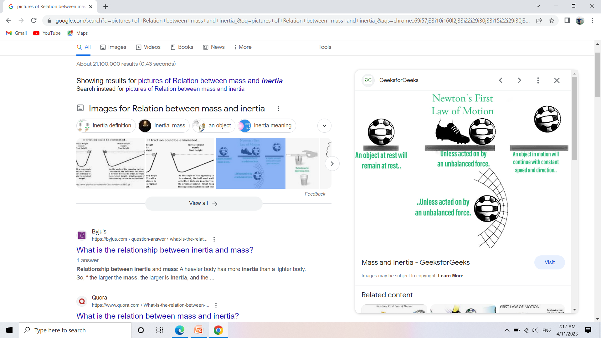
Go'6gsf] rfn;DaGwL klxnf] lgod -Newton's first law of motion)
Go'6gn] rfn ;DaGwL lgodx¿ k|ltkfbg ug{'k"j{ j}1flgs Uoflnlnof] UoflnnL -Galileo Galilei_ n] rfn;DaGwL Jojl:yt ?kn] cWoog u/L Ogl;{ofsf] lgod lbO ;s]sf lyP .
Go'6gsf] rfn;DaGwL klxnf] lgodcg';f/ s'g} c;Gt'lnt ansf] k|of]u gx'Gh]n ;Dd l:y/ cj:yfdf /x]sf] j:t' l:y/ cj:yfd} /xG5 / rfn cj:yfdf ePsf] j:t' ;dfg ultn] pxL lbzfdf rfn cj:yfd} /lx/xG5 .
o; lgodcg';f/ olb kl/0ffTds an -resultant force_ z"Go ePdf j:t' oyfl:ytLdf /xG5 .
l:y/ cj:yfaf6 rfndf Nofpg / ;dfg ultn] u'l8/x]sf] j:t'nfO{ l:y/ cj:yfdf Nofpg c;Gt'lnt an nfUg'k5 . o; lgodn] c;Gt'lnt an gnfu'Gh]n l:y/ cj:yfdf /x]sf] j:t' l:y/ cj:yfd} /xg vf]Hg]/ rfn cj:yfdf /x]sf] j:t' rfn cj:yfd} /xg vf]Hg] u'0faf/] pNn]v ug]{ ePsfn] o;nfO{ Ogl;{ofsf] lgod -law of inertia_ klg elgG5

Slide 27
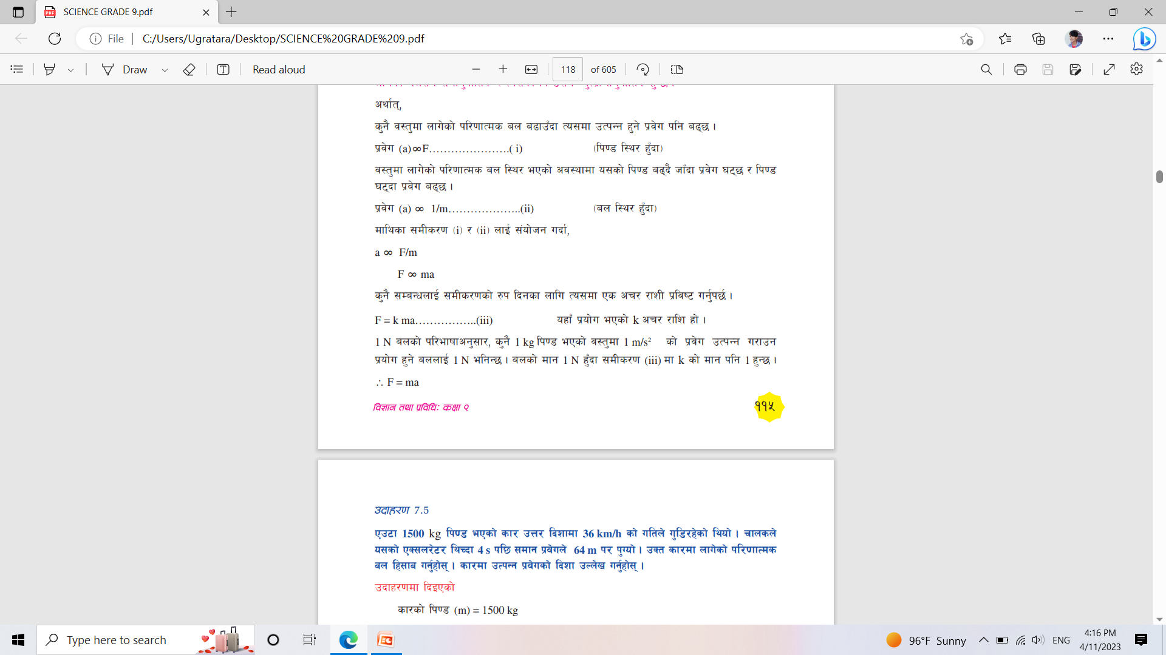
rfn ;DaGwL Go'6gsf] bf];|f] lgod (Newton's second law of motion)
-Prove that F=ma)
ansf] k|of]uaf6 s'g} j:t'df pTkGg x'g] k|j]u To;df nfu]sf] an;Fu ;dfg'kflts / To;sf] lk08;Fu Jo'Tj|mdfg'kflts x'G5 .

Slide 28
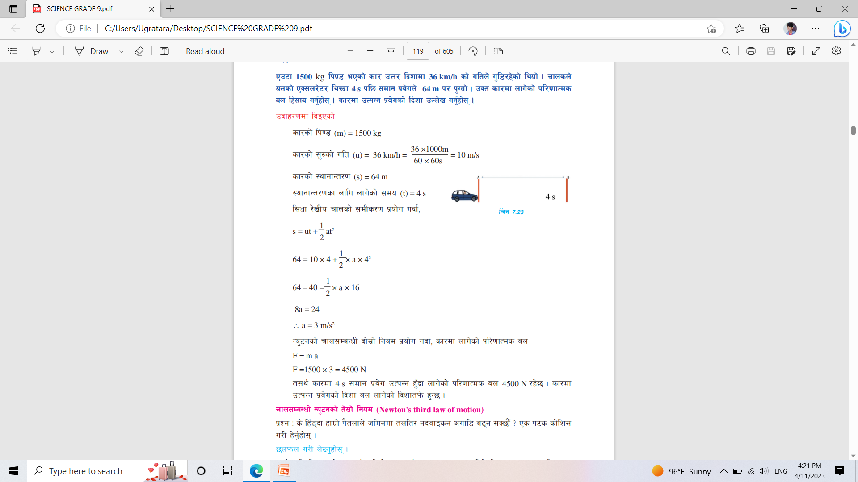
Pp6f 1500 kg lk08 ePsf] sf/ pQ/ lbzfdf 36 km/h sf] ultn] u'l8/x]sf] lyof] . rfnsn] o;sf] PS;n/]6/ lyRbf 4 s kl5 ;dfg k|j]un] 64 m k/ k'Uof] . pSt sf/df nfu]sf] kl/0ffTds an lx;fa ug'{xf];\ . sf/df pTkGg k|j]usf] lbzf pNn]v ug'{xf];\

Slide 29
-!_ ;'/hsf] lk08 50 kg / pgn] r9]sf] ;fOsnsf] lk08 12 kg /x]sf] 5 . pgn] cf]/fnf]
af6f]df ;fOsn u'8fpFbf 2 m/s2 sf] k|j]u pTkGg eof] . pSt cj:yfdf ;fOsndf nfu]sf]
kl/0ffTds an lx;fa ug'{xf];\ . (124N)
-@_ Pp6f 1500 kg lk08 ePsf] sf/ 72 km/h sf] ultn] u'l8/x]sf] lyof] . rfnsn] a|]ssf] k|of]u ubf{ 50 m sf] sf] ult 10 km/h eof] . pSt cjlwdf sf/df nfu]sf] kl/0ffTds an lx;fa ug'{xf];\ . (5850 N )

Slide 30
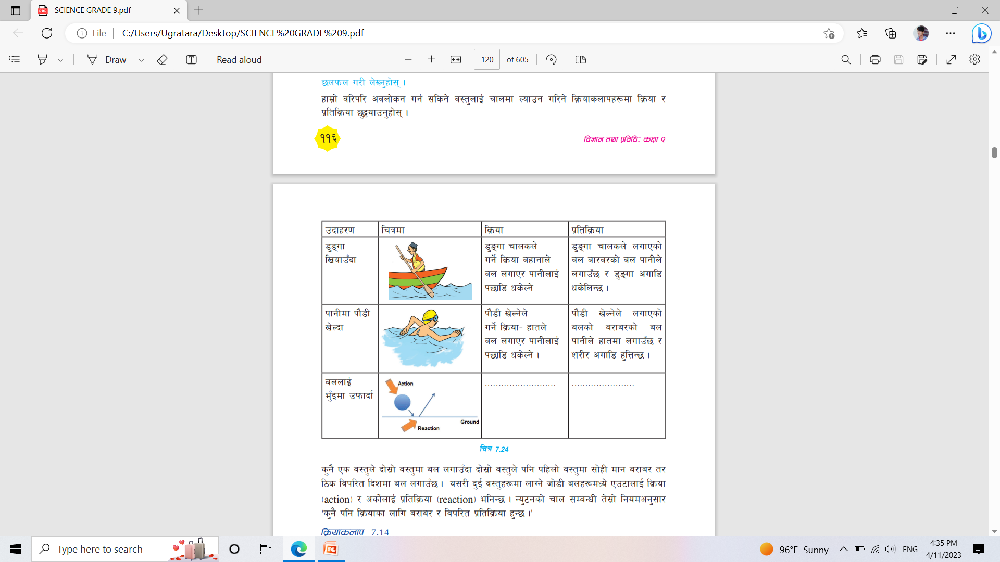
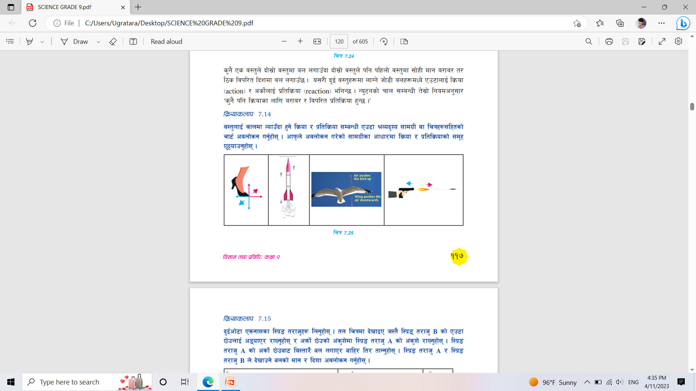
rfn;DaGwL Go'6gsf] t];|f] lgod (Newton's third law of motion)
b'O{ j:t'x¿df nfUg] hf]8L anx¿dWo] Pp6fnfO{ lj|mof -action_ / csf]{nfO{ k|ltlj|mof -reaction_ elgG5 .
s'g} klg lj|mofsf nflu a/fa/ / ljkl/tk|ltlj|mof x'G5 .
Some Examples of Newtons third law of Motion.

Slide 31
lj|mof / k|ltlj|mofdf a/fa/ kl/df0f / ljkl/t lbzf eP tf klg Psn] csf{nfO{ /2 ub}{g .
ha b'O{ a/fa/ / ljk/Lt an Pp6} j:t'df nfUb5g\ ta dfq kl/0ffTds an -resultant force_ z"Go x'G5 .
lj|mof / k|ltlj|mof b'O{ km/s ;txdf nfUg] ub{5g\ .
lj|mof / k|ltlj|mofdf Psn] csf{nfO{ /2 ug]{ x'Fb}g .

Slide 32
Onfl:6l;6L / Knfl:6l;6L -Elassticity and Plasticity)
s'g} j:t'df ljleGg lbzfaf6 an nufpFbf ;du|df Psn ansf] ?kdf kl/0ffTds an -resultant force_ sf] c;/ b]lvG5 .
j:t'sf] agfj6, nufOPsf anx¿sf] kl/df0f tyf lbzfcg';f/ kl/0ffTds ann] j:t'sf] cfsf/ / ;fOh kl/jt{g ug{ ;S5 . kl/0ffTds an h;n] j:t'sf] cfsf/ / ;fOhdf kl/jt{g NofpF5 To;nfO{ l8kmld{ª an -deforming force_ elgG5.
s'g} l8kmld{ª j:t'af6 l8kmld{ª annfO{ x6fpFbf cfk\mgf] d"n cj:yf k|fKt ug]{ u'0f Onfl:6l;6L xf] .
agfj6sf cfwf/df j:t'x¿df km/s km/s Onfl:6l;6L x'G5.
Onfl:6l;6L a9L x'g] j:t'n] l8kmld{ª ansf] a9L cj/f]w ub{5 / pSt an x6fpFbf Psbd} rfF8f] oyfl:yltdf kms{G5

Slide 33
l:6nsf] Onfl:6l;6L Psbd} a9L x'g] ePsf o;sf] k|of]u alnof] 3/, k'n, cflb lgdf{0fsf nflu ul/G5.
j:t'nfO{ Onfl:6l;6L ;LdfeGbf a9L tGsfpFbf pSt j:t' :yfoL ?kdf l8kmd{D8 x'G5 / Onfl:6l;6L x/fpF5 .
ansf] k|of]un] j:t'sf] cfsf/ / ;fOhdf :yfoL ?kn] kl/jt{g cfpg] u'0fnfO{ Knfl:6;L6L elgG5 .
Knfl:6l;6Ln] ubf{ df6f]nfO{ ;lhn} cfsf/ lbP/ OF6f agfpg ;lsG5 .
:yfoL ?kn] l8kmd{D8 j:t'df lg/Gt/ an a9fpFbf r'Fl8g] jf eflrg] x'G5

Slide 34
5nkmn ug'{xf];\ M
!= s] an nufpFbf tlGsPsf] b]lvg] j:t'x¿ dfq Onfl:6s x'g\ <
@= Onfl:6s j:t'sf u'0fsf cfwf/df /a/ / l:6ndWo] s'g a9L Onfl:6s x'G5 <
        kl/of]hgf sfo{
-s_ cfk\mgf] jl/kl/ pknAw ;fdu|Lx¿sf] k|of]u u/L a]n'gaf6 rNg] 6f]o sf/ lgdf{0f ug'{xf];\ . pSt sf/df km/s km/s Onfl:6l;6L ePsf u'Aaf/f / ljleGg tf}nx¿sf] k|of]uaf6 Go'6gsf] rfn ;DaGwL bf];|f] lgod k|bz{g ug'{xf];\ .
-v_ :yfgLo ?kdf pknAw ;fdu|Lx¿ / /a/ a]G8sf] Onfl:6l;6Lsf] k|of]u u/L Pp6f 6f]o x]lnsf]K6/ lgdf{0f ug'{xf];\ .

Slide 35

Madhav Raj Pant
Science Teachers Associations Nepal (STAN)
Sudoorpashim Nepal

