Slide 1


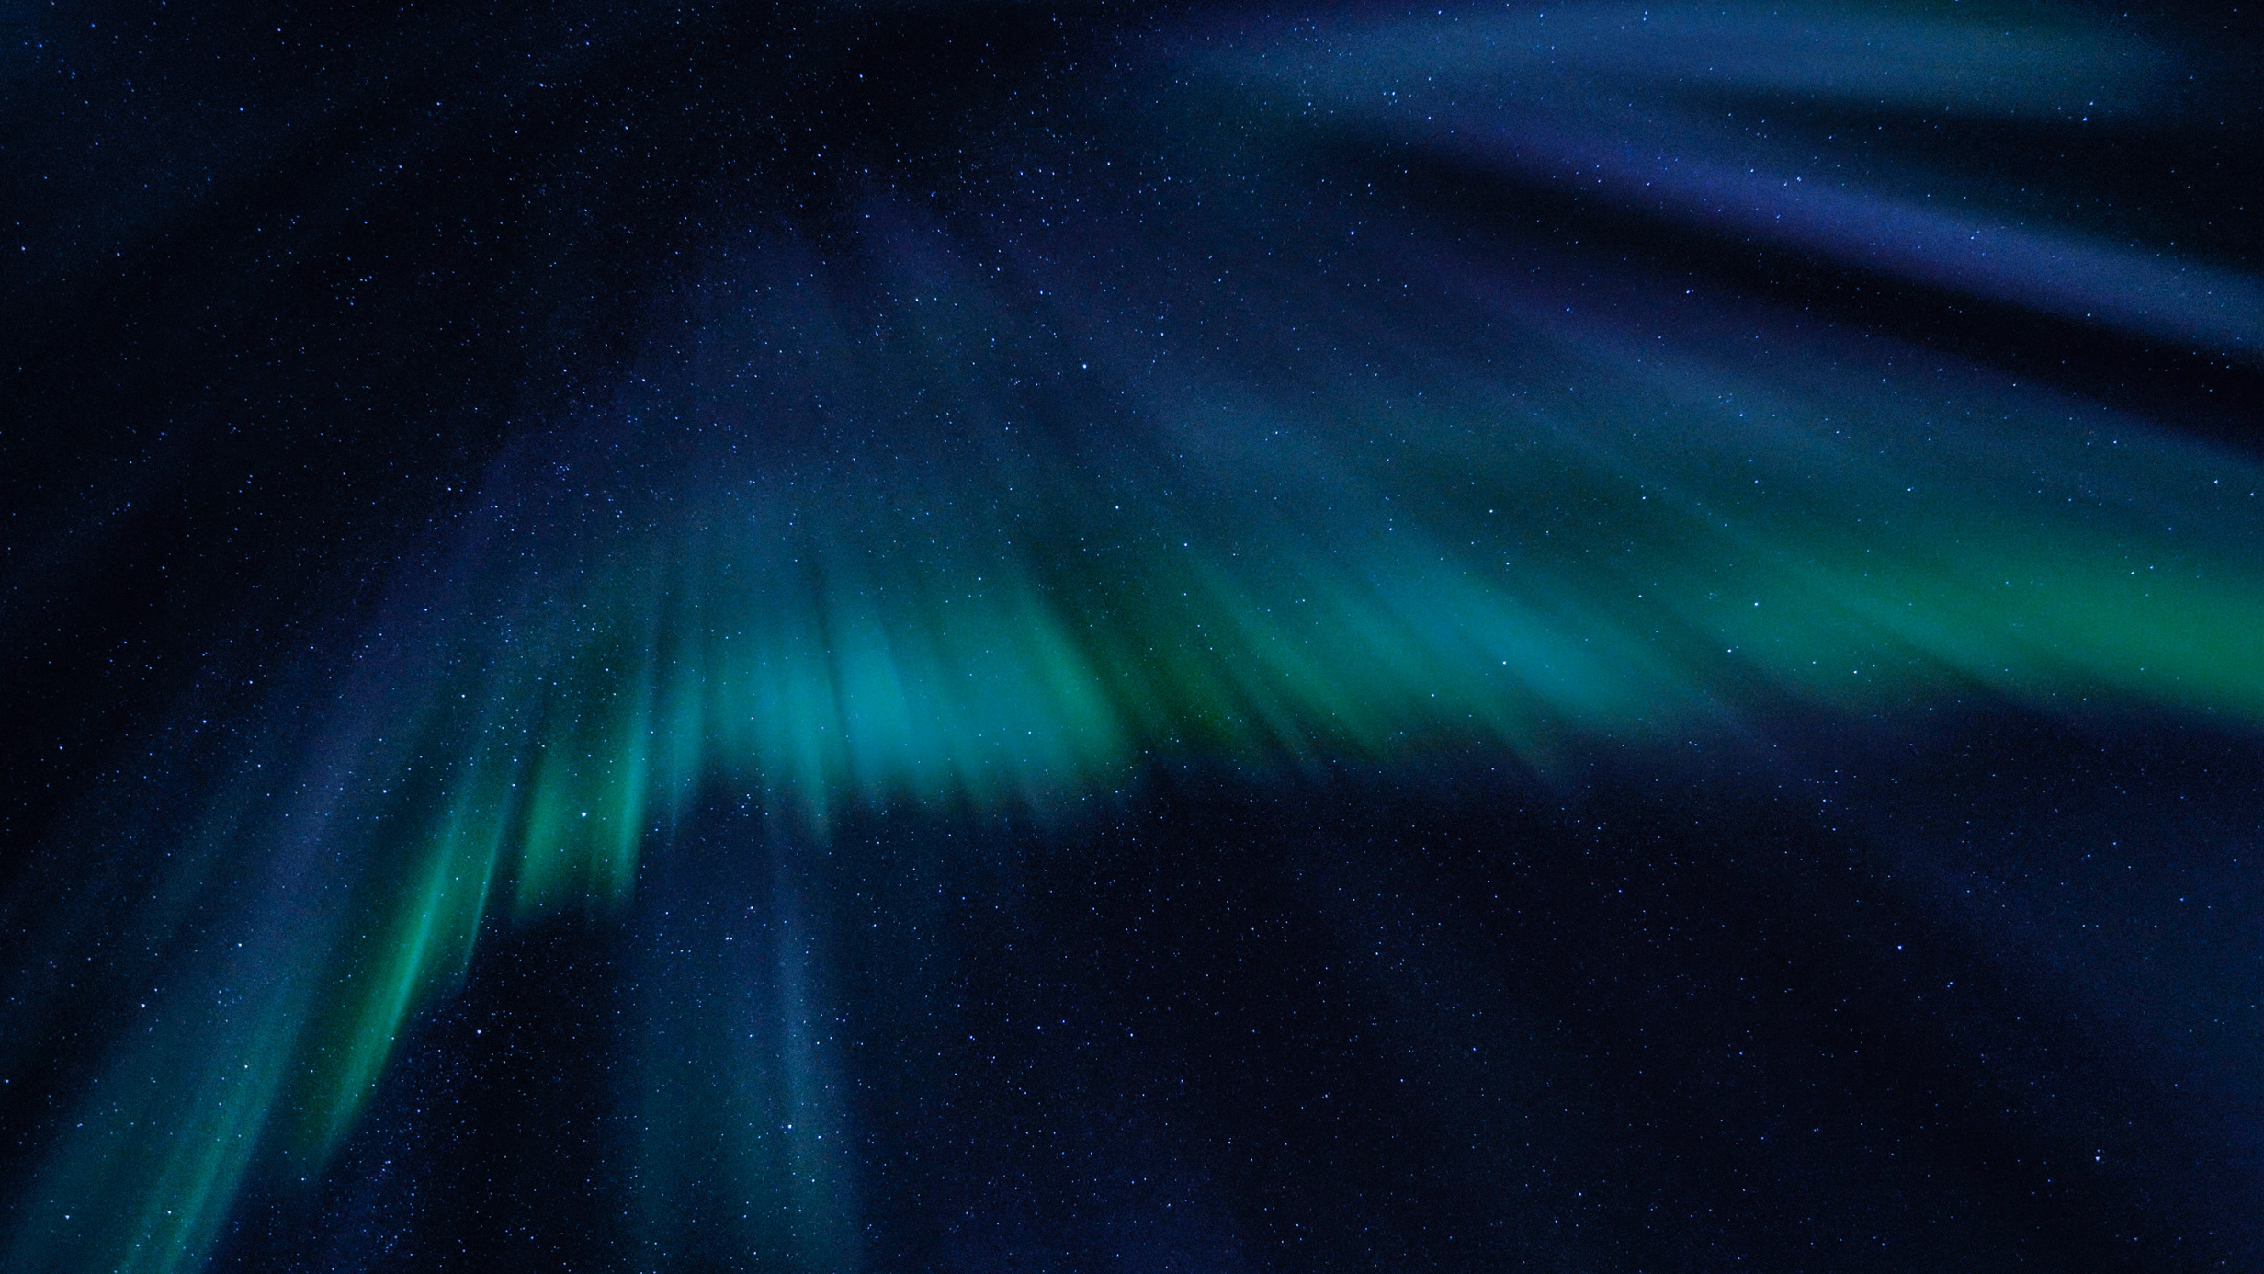





ICT
INFORMATION &
COMMUNICATION
TECHNOLOGY
Persentation by
Chandrakala Dawadi

Slide 2
Telecommunication
1
  Role of Artificial Satellite
SYLLABUS
  2
  Searching in internet
  3
  Online security
  4
  Cyber bullying
  5

Slide 3

TELECOMMUNICATION
Tele- long distance
Communication- Act of transmitting information

Slide 4
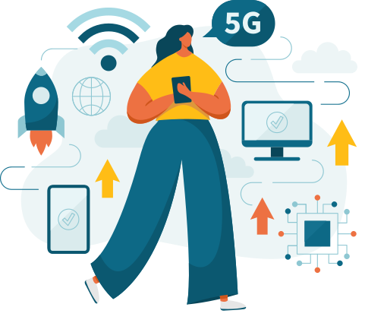
MEANS OF TELECOMMUNICATION
Radio
Television
Telephone
Mobile phone
Computer
Fax etc.

Slide 5

PRINCIPLE OF TELECOMMUNICATION
Telecommunication occurs in following 3 steps:-
1.Transmission ( input)
2.Channel ( Wave or current)
3.Receiver

Slide 6
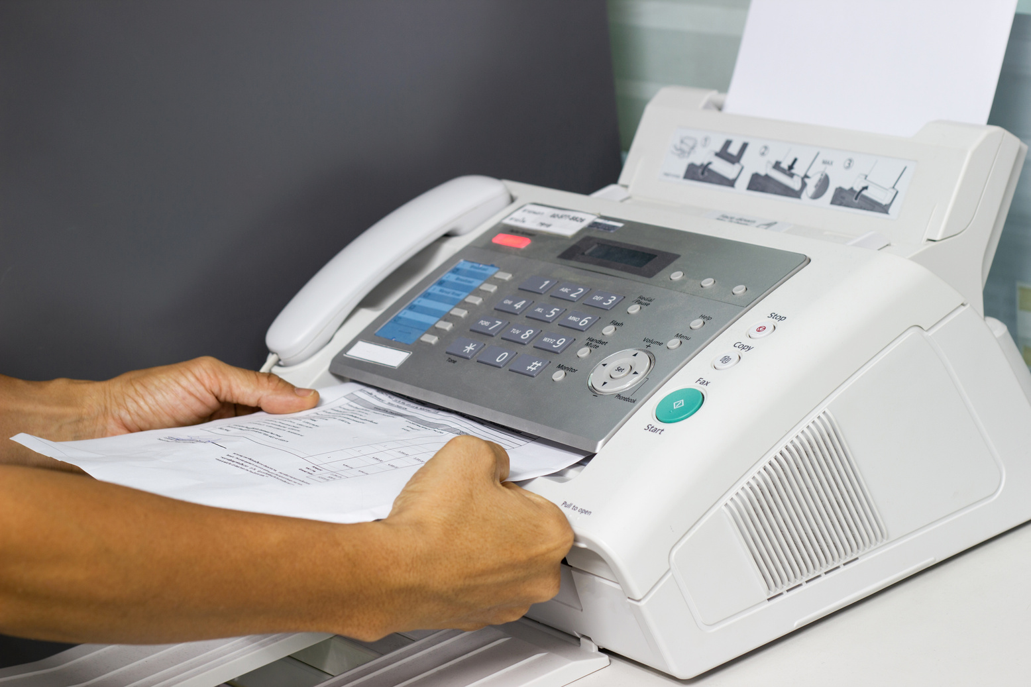
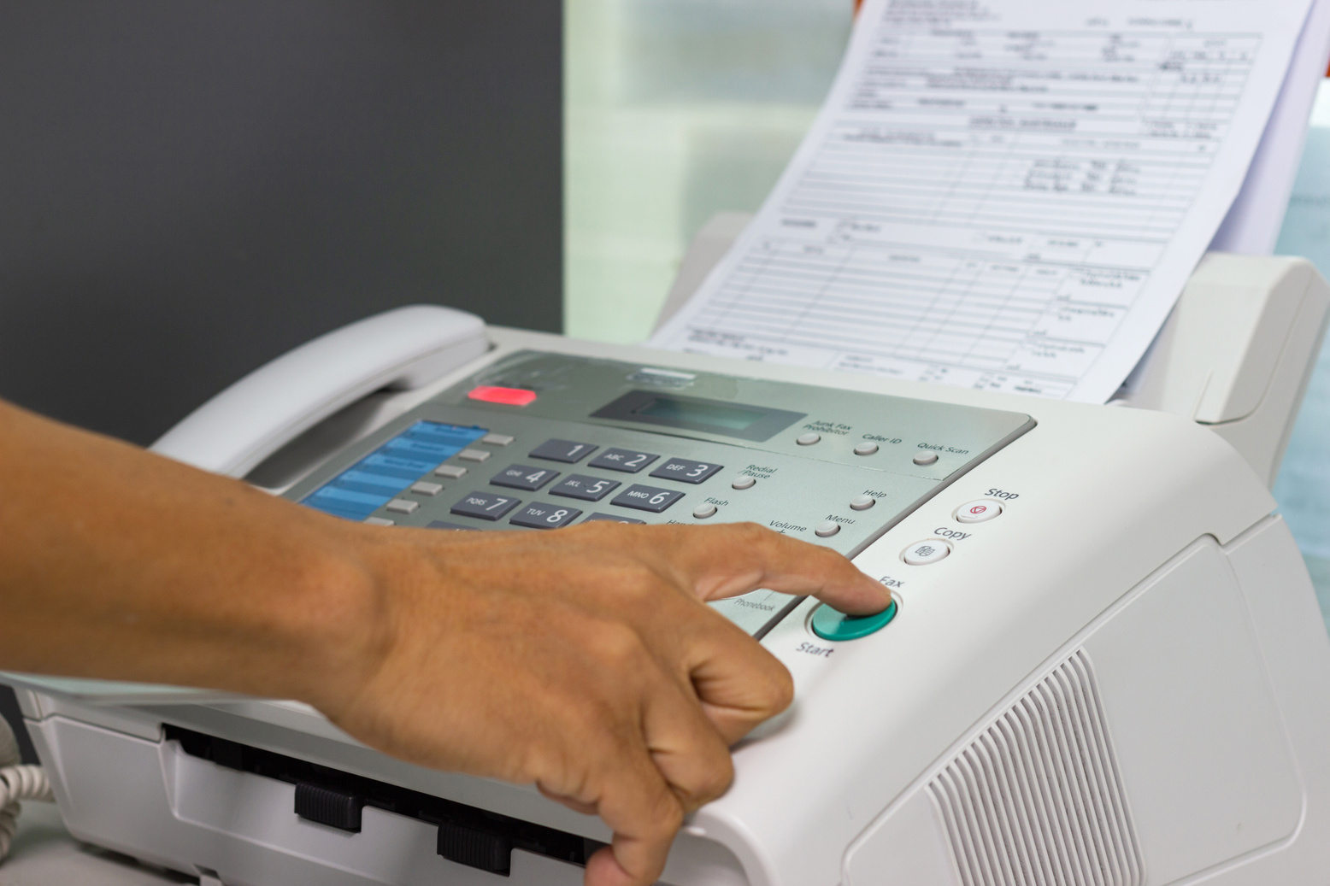
Fax or facsimile
Image is scanned in a sender fax and converted into electric signal then transmitted through telephone system to receiving fax machine.

Slide 7


Telephone system and fax has electrical singnal so wire is used as channel.
Ear piece
Mouth piece
Dial

Slide 8
Wi-Fi : wireless fidelity is a wireless local area network (WLAN,)technology.
Cellphones is bidirectional radio that enables simultaneous transmission and reception.

Slide 9
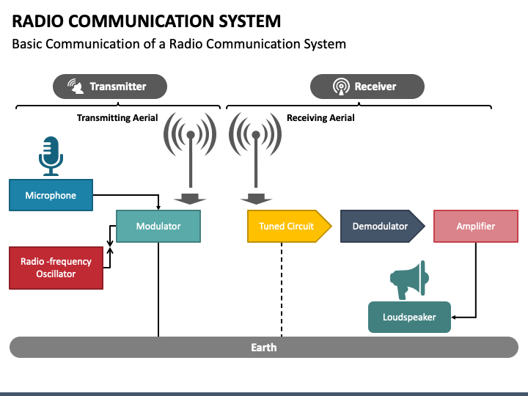
Unidirectional Directional Communication

Slide 10
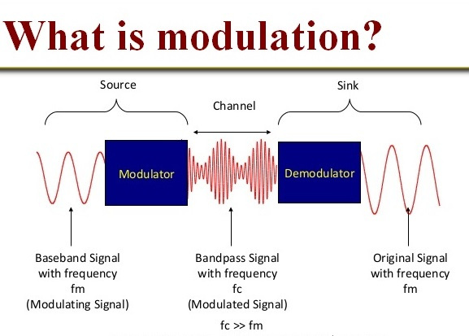
Process of changing the signal parameters like frequency, amplitude etc.

Slide 11
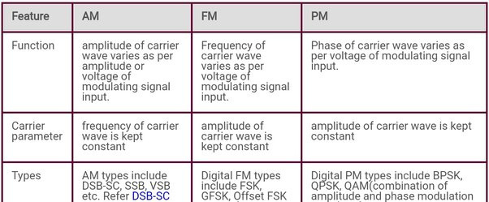
Amplitude
modulation
Frequency
modulation
Phase
modulation
Noise immunity : FM>PM>AM so music station uses FM.

Slide 12
1. Why is modulation necessary in radio communication?
The frequency of the message signals to be transmitted is low. The strength of the message signals should be increased to transmit up to long distance. So, radio communication signals are modulated to transmit correctly in long -distance range.
2. Which is better among FM and AM?
A distinct advantage that FM has over AM is that FM radio has better sound quality than AM radio. The disadvantage of FM signal is that it is more local and cannot be transmitted over long distance

Slide 13
Internet
A global computer network providing a variety of information and communication facilities, consisting of interconnected networks using standardized communication protocols.

Slide 14
E-mail
A messages distributed by electronic means from one computer user to one or more recipients via a network.
How to make email id and use it?

Slide 15

Search Engine
A software that is designed to carry out web searches.

Slide 16


Slide 17
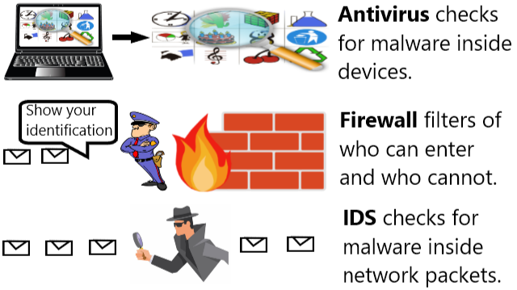
Internet Security

Slide 18
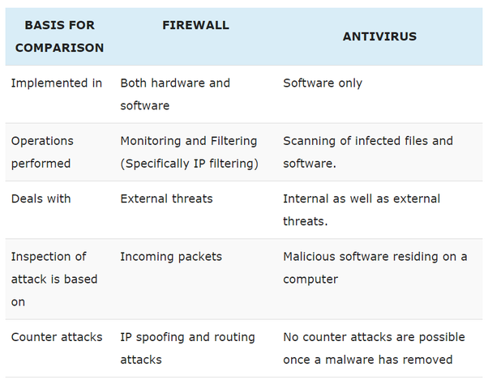

Slide 19
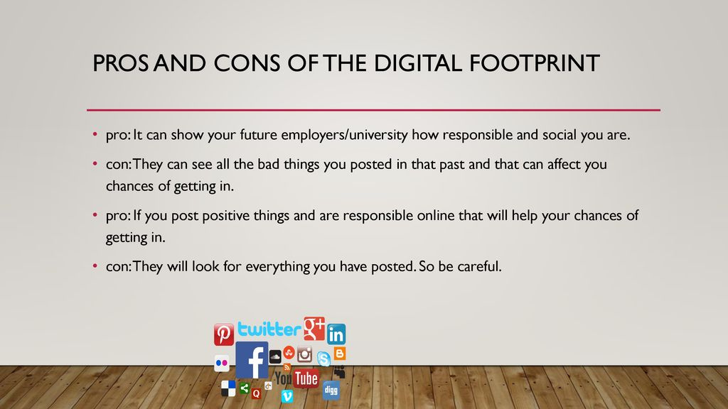
Digital footprint
The information about a particular person that exists on the internet as a result of their online activity.

Slide 20
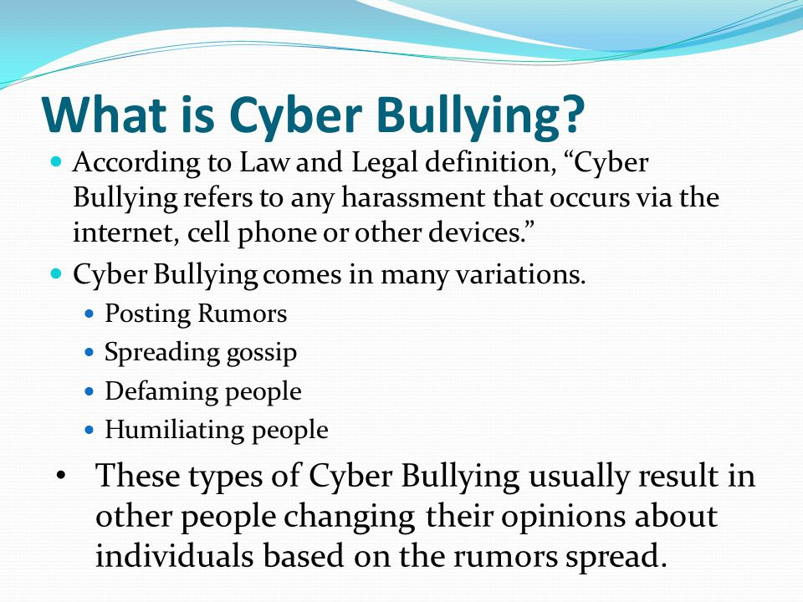

Slide 21


Slide 22
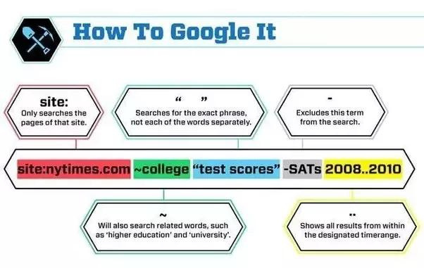

Slide 23
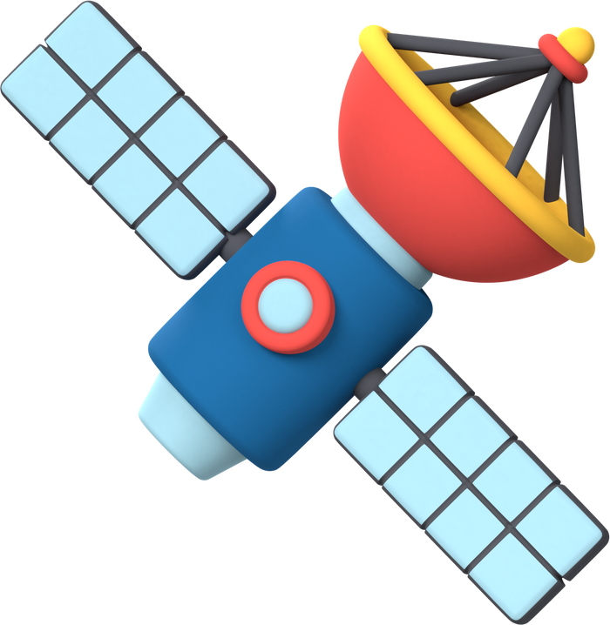
SATELLITE
Object that revolve around planet
In telecommunication artificial satellites are used which don't require energy for revolving around earth . For running of electric components solar panels are fit .

Slide 24
ORBITS OF SATELLITE 🛰️
1. LEO( Low Earth orbit ):
160 to 2000 km above earth, geographic survey
2. MEO( Medium Earth Orbit):
2000 km to 35,786 km above earth, Navigation satellite
3. GEO( Geostationary Earth Orbit):
35,786 km directly above equator , Communication satellite

Slide 25

COMMUNICATION SATELLITES ARE PLACED IN GEO. WHY?
Geostationary orbit satellite remain stationary with respect to earth. The earth station doesn't lose connection with communication satellites in GEO as the earth rotates on its axis. So, the communication satellites are placed in GEO.
Revolution period of GEO satellite:
24 Hours

Slide 26
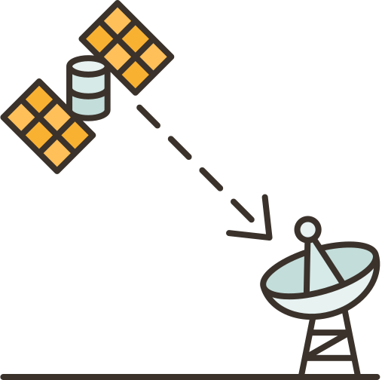
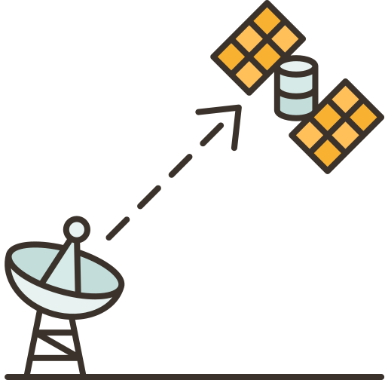
PRINCIPLE OF SATELLITE
COMMUNICATION
Satellite transponder
Satellite communication
contains 3 main components.
Uplink
Downlink

Slide 27
1. Uplink:
It is a link between earth station to satellite.
2. Satellite transponder
It receives signal from earth station and modifies the ( modulation)
incoming signal for sending down to receiver station.
3.Downlink
It is a link from satellite to
ground station receivers.

Slide 28
Satellite Navigation System
Technology to determine ground position of an object
GPS: Global positioning system ( USA- first country to use this technology)
RGNSS: Russian Global Navigation Satellite System
IRNSS: Indian Regional Satellite System

Slide 29
Application of GPS:
1. Position identification
2. Path tracking

Slide 30
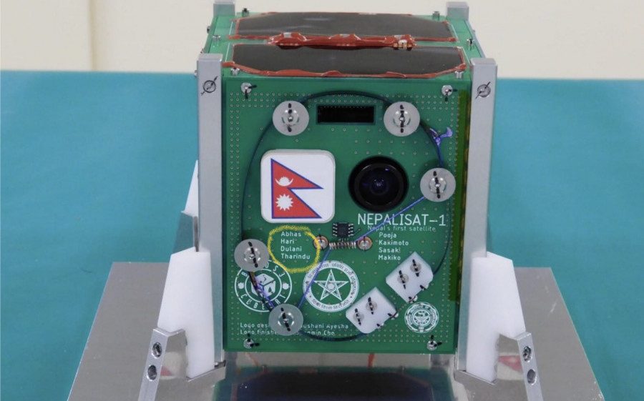
Nepal's first Satellite
NepaliSat-1, also known as Bird NPL,was a Nepalese low orbit research satellite and the first satellite of Nepal. Along with a Sri Lankan satellite, Raavana 1, it was launched as part of Cygnus NG-11 by the United States on 17 April 2019.It reached the International Space Station on 19 April 2019, to be deployed later, and was estimated to revolve the Earth for six months.
Nepali sat-1/Bird NPL

Slide 31
The nanosatellite was developed by two Nepalese scientists Aabhas Maskey and Hariram Shrestha , both of whom were at the time studying at Japanese Kyushu Institute of Technology. Aabhas Maskey, a PhD candidate in space engineering was the project manager of the Birds-3 project and he involved himself in this project.The satellite had a mass of 1.3 kg and it was funded by the Nepal Academy of Science and Technology while it was constructed under the BIRDS-3 project of the Japanese Kyushu Institute of Technology.The main mission of Birds Program was to support countries who have never sent a satellite to space.The development of the satellite cost nearly twenty million Nepalese rupee.The satellite contained Nepal's flag and Nepal Academy of Science and Technology (NAST) logo, alongside the developers name.

Slide 32


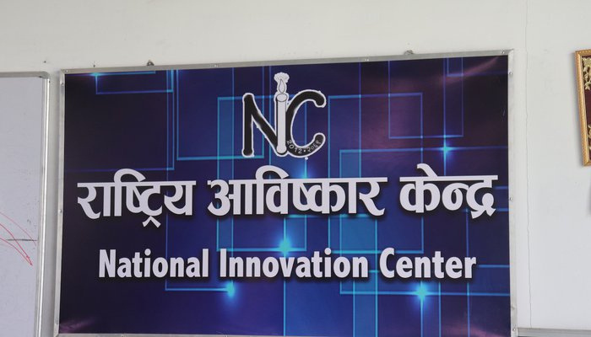
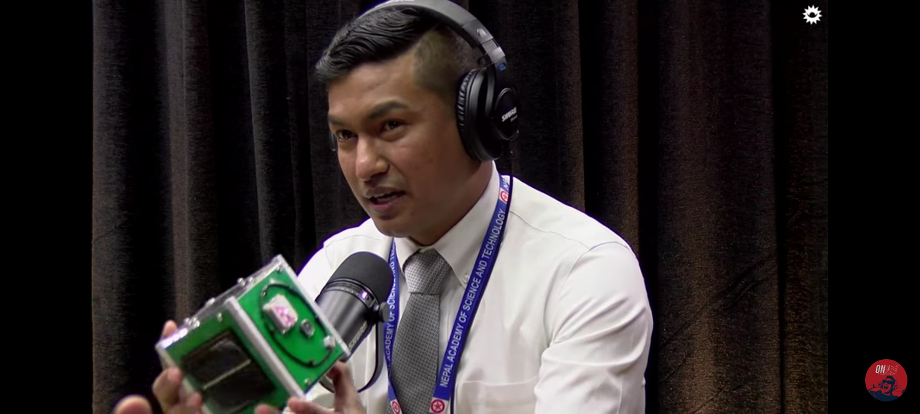
Hareram Shrestha
Abhas Maskey

Slide 33
Prime minister of Nepal Khadga Prasad Oli congratulated the scientists via Twitter by writing, "Though a humble beginning, with the launching of NepaliSat-1 Nepal has entered the Space-Era. I wish to congratulate all those scientists and institutions that were involved right from the development to its launching thereby enhancing the prestige of our country Suresh Kumar Dhungel, spokesman for Nepal Academy of Science and Technology (NAST), said, "...they invested in the satellite in a bid to open new paths for space engineering in the country.
After the successful launch of this satellite another group of engineering graduates were working on another satellite named "Nepal PQ-1", prepared to launch in 2020

Slide 34

THANK YOU

