Slide 1
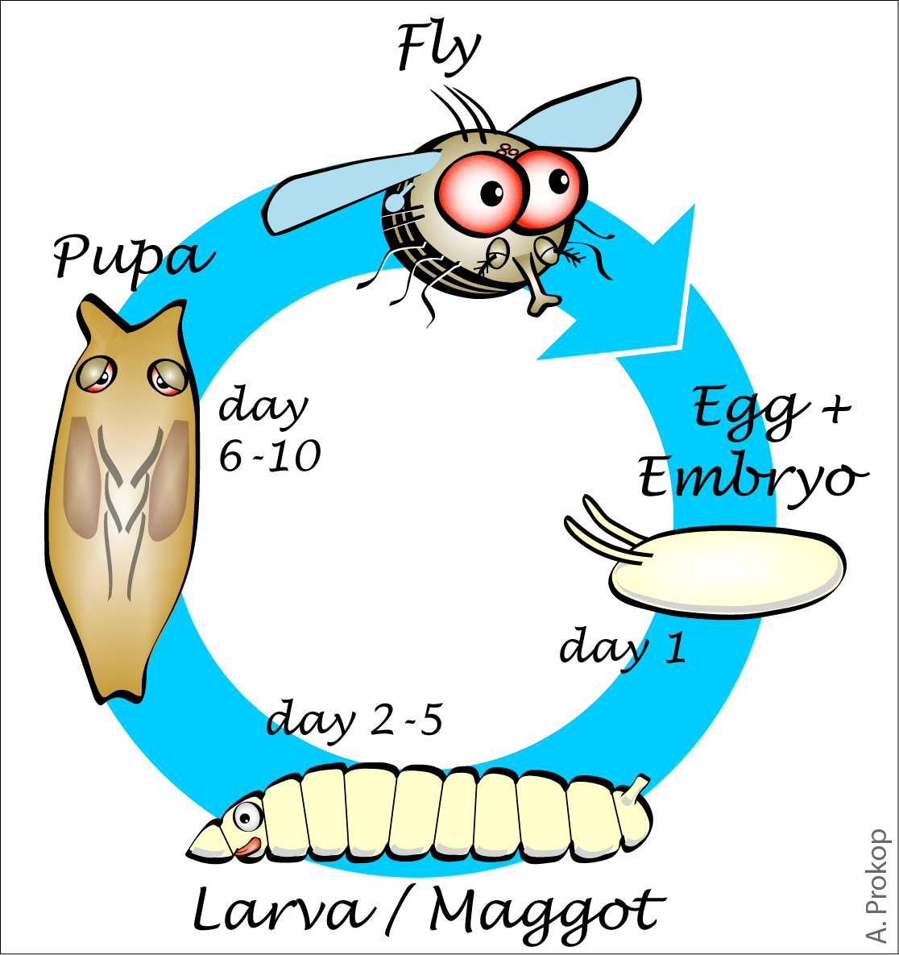
विज्ञान तथा प्रबिधि
एकाइ:तीन
कक्षा: १०
जीवन चक्र (Life cycle)
पाठ्यघण्टाः ४

Slide 2
सिकाइ उपलब्धि
o; PsfOsf] cWoog kl5 tkfO{ lgDgलिखित sfo{ ug{ ;Ifd x'g'x'g]5 M
df}/Lsf] hLjg rqmsf] JofVof ug{ .
df}/Lsf] pkof]lutf atfpg .

Slide 3
z}lIfs ;fdu|L
विभिन्न मौरीहरू(रानी मौरी,भाले मौरी र कर्मी मौरी) का चित्रहरू मौरीको जीवन चक्रका बिभिन्न अवस्था देखाउने भिडियो, चार्ट पावर प्वाइन्ट स्लाइडहरू

Slide 4
पाठ्यबस्तुहरू
Day:1
Day:2
Day:3
Day:4

Slide 5
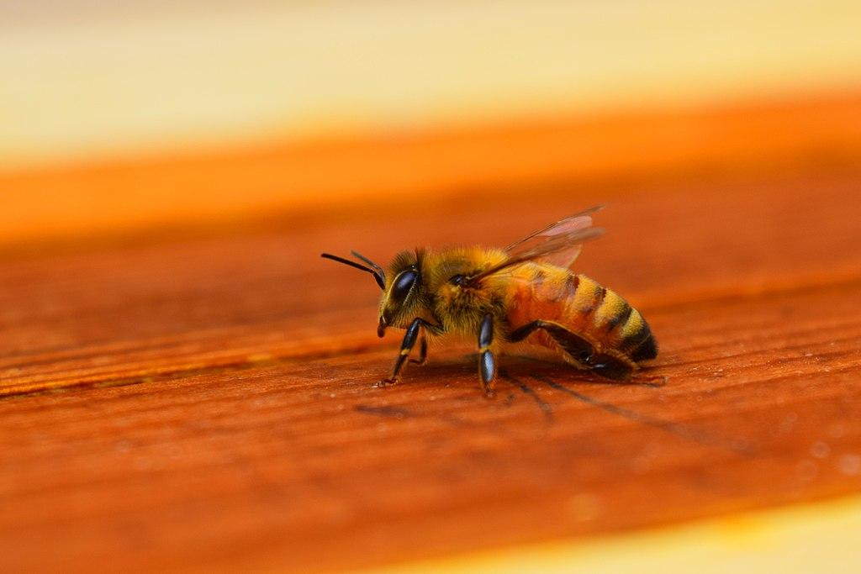
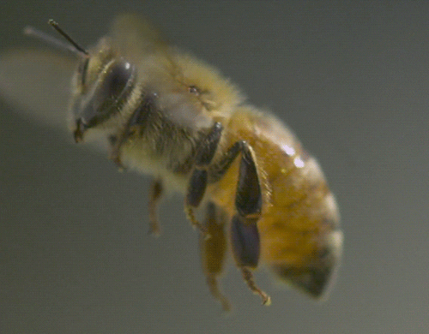
मौरी (Honey Bee)
ljifoj:t'
kl/ro, k|sf/
zf/Ll/s agf]6
hLjg rqm
उपयोगिता
Classification
KINGDOM | ANIMALIA
SUB-KINGDOM | INVERTEBRATE
PHYLUM | ARTHROPODA
CLASS | INSECTA

Slide 6
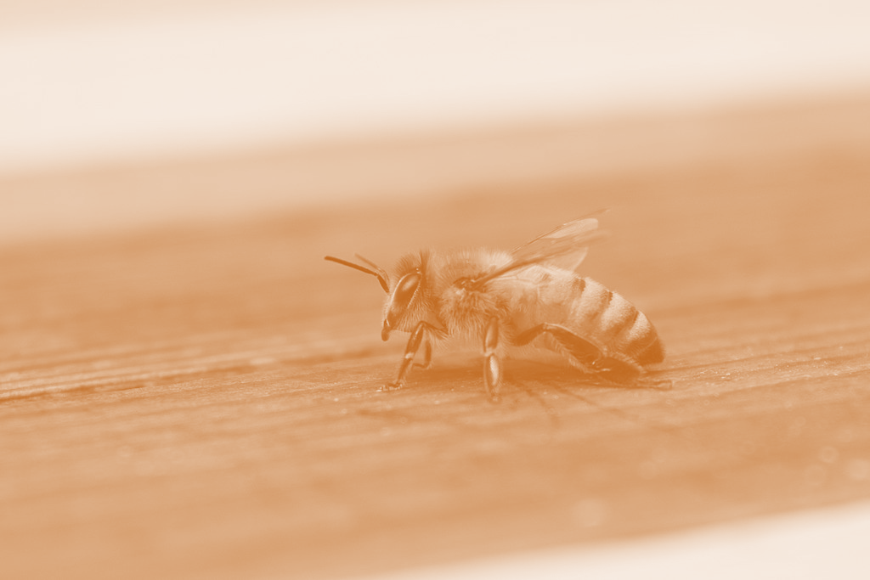
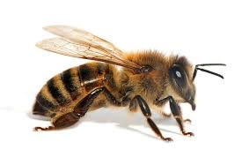
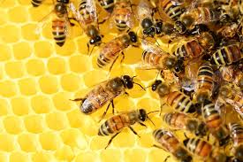
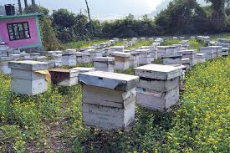
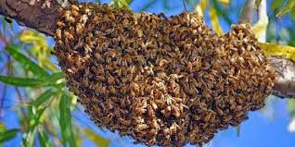
परिचय
df}/L 7'nf] ;d"xdf a:g] ;fdflhs ls/f xf] .
of] cfy|f]kf]8f kmfOnddf kb{5 .
o;n] kf}li6s tTTjo'St dx pTkfbg u5{ .
df}/Lx¿n] k'mnsf] /; vfg] u5{g\ .
logLx¿ ;ङul7t ¿kdf ;d"xdf a:5g\ .
logLx¿ pRr ;dembf/L / s8f cg'zf;gdf /x]sf x'G5g\.

Slide 7
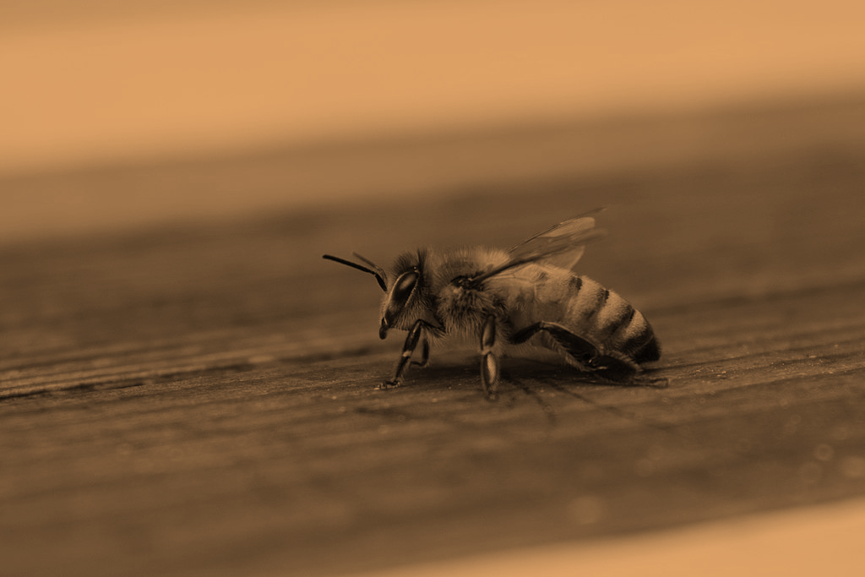
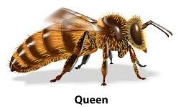
df}/Lsf k|sf/
Pp6f 3f/df # k|sf/sf df}/L x'G5g\.
/fgL df}/L, efn] df}/L / sld{ df}/L
/fgL df}/L (Queen Bee):
3f/df cGo df}/L भन्दा cln 7"nf] / ;nSs k/]sf] nfDrf] cfsf/sf] df}/L /fgL df}/L xf] .
o;sf] 6fpsf] c¿sf] eGbf ;fgf] / 8f]nf] x'G5 eg] ;'8 5f]6f] x'G5 .
/fgL df}/Lsf] k]6sf] cGtdf ;fgf] lvn x'G5 .
;fdfGo cj:yfdf Pp6f uf]nfdf Pp6f dfq /fgL df}/L x'G5 .
o;sf] d'Vo sfd k'mn kfg'{ xf] .
o;n] uf]nfsf] ;Dk"0f{ df}/LnfO{ kl/l:yltcg';f/ ;~rfng u5{ .
o;sf] z/L/af6 ljz]if lsl;dsf] uGw cfp5 / Tof] uGw uf]nfsf] ;Dk"0f{ df}/Ln] u|x0f u/]sf x'G5g\ . o;}sf cfwf/df df}/Ln] आफ्नो uf]nf kQf nufउं5 .

Slide 8
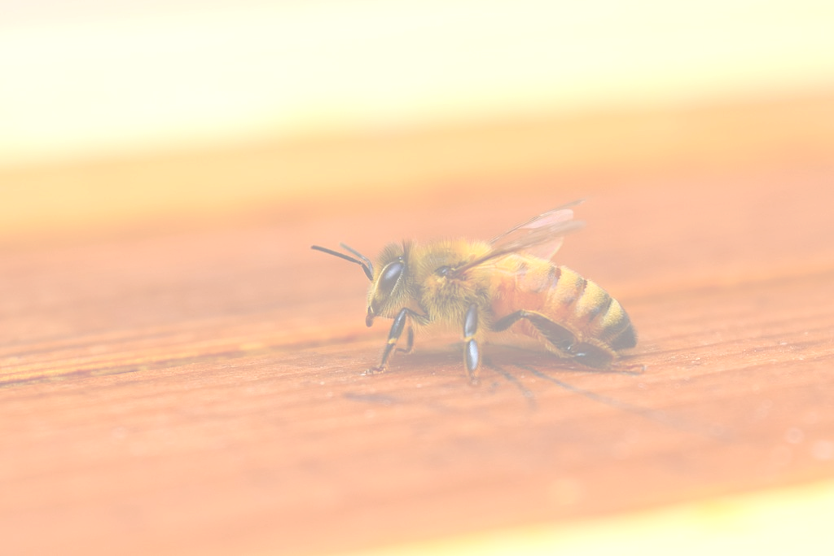
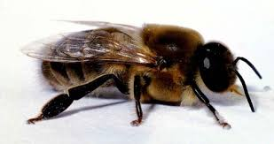
df}/Lsf k|sf/
Effn] df}/L(Drone Bee) :
efn] df}/L /fgL df}/LeGbf ;fgf] t/ sdL{ df}/LeGbf 7"nf], sfnf] / e'ml;nf] x'G5 .
o;sf] ljif u|lGy, dx ;ङsng u|lGy / v'6\6fdf k/fu y}nL s]xL klg x'b}g .
logLx¿nfO{ vfgf;d]t sdL{ df}/Ln] v'jfpg'k5{ .
Effn] df}/Lsf] Ps dfq sfd /fgL df}/LnfO{ uef{wfg u/fpg' xf] .

Slide 9
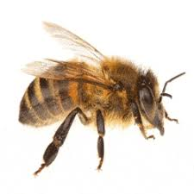
df}/Lsf k|sf/
sdL{ df}/L (Worker Bee) :
df}/Lx¿sf] ;d"xdf sdL{ df}/L ;a}eGbf ;fgf] x'G5 .
o;sf] z/L/ 6fpsf], 5ftL / k]6 u/L tLg v08df 5'6\l6Psf] x'G5 .
o;sf] d'vn] rkfpg] (chewing) / rf6\g] (lapping) u5{ .
h;n] ubf{ sdL{ df}/Ln] k'mnsf] /; ;lhn};u hDdf ug{ ;S5g\
o;sf] tLg hf]8f v'6\6f x'G5 / k|To]s v'6\6f /f}n] 9flsPsf] x'G5 .
o;sf] v'6\6fdf k'mnsf] /; hDdf ug{sf nflu kf]n]g af:s]6 x'G5 .

Slide 10
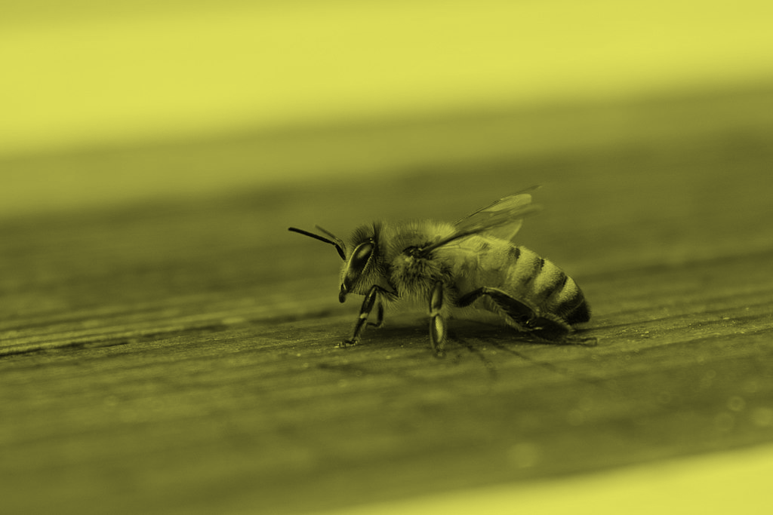
df}/Lsf] hLjgrqm
Dff}/Lsf] 3f/df df}/Lx¿sf] सङ्ख्या lgs} a9]df /fgL df}/Ln] (old queen) y'k|} sdL{ df}/Lx¿;u ldnL gof ;d"x lgdf{0f u5{ . o:tf] cj:yfdf 3f/df gof /fgL df}/L aG5 .
/fgL df}/Lsf] d]l6ङ फ्nfO6 (mating flight) jf
gKrn फ्nfO6 (nuptial flight) x'G5 .
/fgL df}/L / efn] df}/L ;Def]u ug{sf nflu dfq} 3f/af6 aflx/ lg:sG5g\ . o;/L 3f/af6 lg:sg] फ्nfO6 (flight) nfO{ d]l6ङ फ्nfO6 elgG5 . hxf y'k|} efn]df}/L;u /fgL df}/Ln] d]l6ङ u5{ .
;a} lsl;dsf df}/Lx¿sf] hLjg rqmdf rf/ cj:yfx¿ x'G5g\ .
k'mn(Egg)
nfef{(Larva)
Ko'kf(Pupa)
jo:s(Adult)

Slide 11
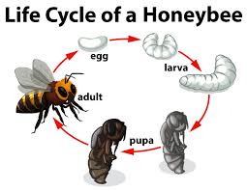
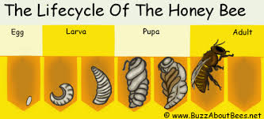

df}/Lsf] hLjgrqm

Slide 12
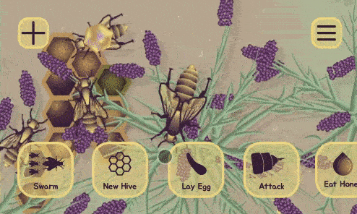

Slide 13
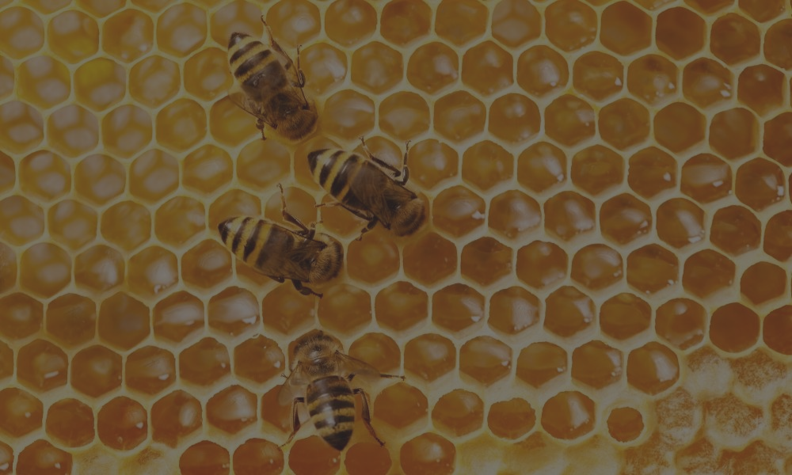
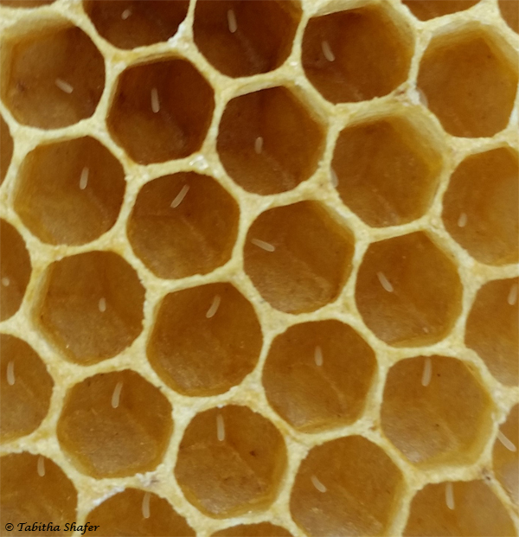
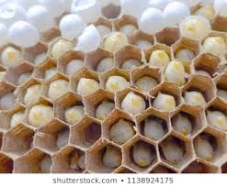
df}/Lsf] hLjgrqm
k'mn (Egg)
/fgL df}/Ln] ;fdfGo cj:yfdf jo:s eP/ lg:s]sf] 3 b]lv 5 lbgdf 3f/ aflx/ xfjfdf uP/ efn];Fu d]l6ङ u5{ . To;sf] 2 b]lv 3 lbgkl5 k'mn kfg{ yfN5 .
/fgL df}/Ln] pko'St ;dodf k|lt lbg 3000 cf]6f;Dd k'mn kf5{ . df}/Lsf] hftcg';f/ k'mnsf] ;\Vof 36a9 x'g ;S5 .
df}/Lsf] k'mn ;]tf] /ङsf] nfDrf] cfsf/sf] x'G5 . h'g klxnf] lbg c08fsf]ifsf] lkwdf 7f8f] x'G5, bf];|f] lbg 9Ns]sf] x'G5 / t];|f] lbgdf 9n]sf] x'G5 .
/fgL df}/Ln] efn] agfpg efn] sf]ifdf, sdL{ agfpg sdL{ sf]ifdf / /fgL agfpg /fgL sf]ifdf k'mn kf5{ .
k'mn cj:yf ;a} df}/Ldf tLg lbg g} x'G5 .

Slide 14
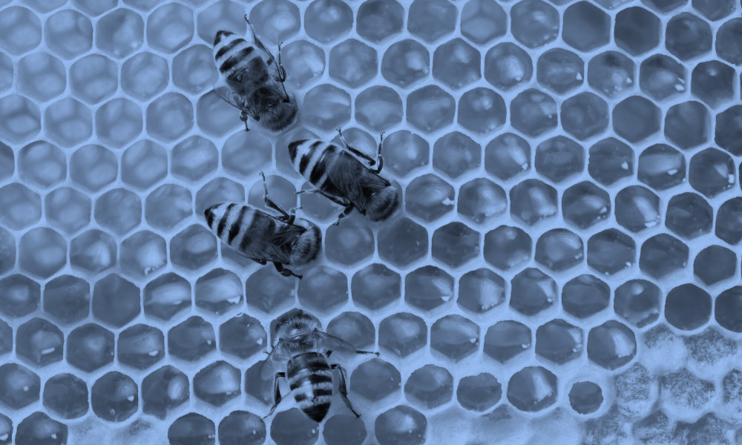
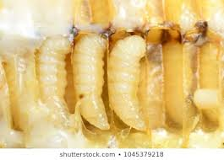
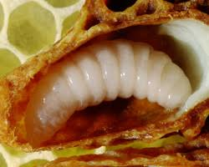
df}/Lsf] hLjgrqm
Nffef{ (Larva)
/fgL df}/Ln] k'mn kf/]sf] 3 lbgkl5 df}/Lsf] lsl;dcg';f/ /fgLsf]ifdf 5-5.5 lbg, sdL{sf]ifdf 6 lbg / efn] sf]ifdf 6 lbg;Ddsf] cjlwnfO{ nfef{ cj:yf elgG5 .
o; cj:yfdf nfef{n] w]/} vfG5 .
/fgL / efn] df}/Lsf] nfef{ sdL{ df}/Lsf] eGbf 7"nf] x'G5 .
/fgL df}/L / sdL{ df}/L b'j} kf]yL x'g\ . To;}n] /fgL df}/L agfpg] jf sfdbf/ agfpg] eGg] s'/f nfef{ cj:yfdf v'jfpg] vfgfdf e/ k5{ . /fgL df}/L agfpg' k/]df nfef{ cj:yfsf] cjlwel/ kf]if0fo'St tTTj (royal jelly) v'jfp5g .
sdL{ df}/L agfpgsf nflu 3 lbg;Dd /f]on h]nL v'jfp5g\ . To;kl5 dw'/f]6L -dx / s'6sf] ld>0f_ v'jfpF5g\ .
Effn] df}/Lsf] nfef{nfO{ klg 3 lbg;Dd kf]if0fo'St vfgf v'jfpF5g\ / To;kl5 dx / s'6sf] ld>0f v'jfpF5g\ .
nfef{ cj:yfdf o;n] 4-5 k6s;Dd sfFr'nL k]m5{ .

Slide 15
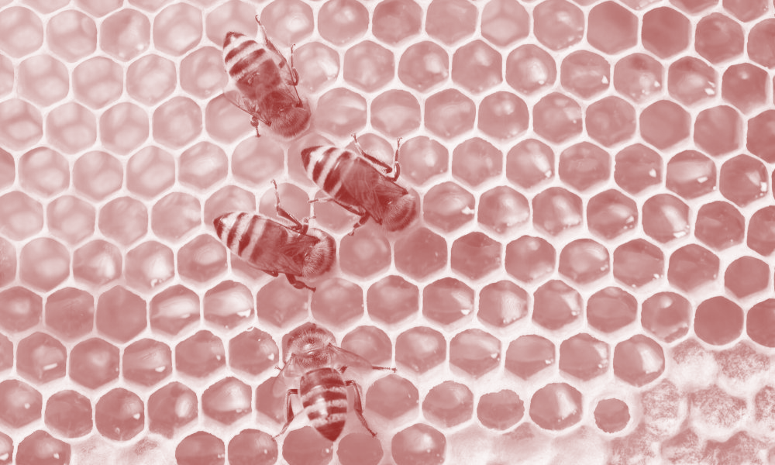
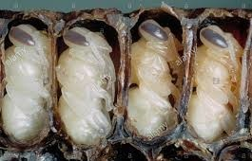
df}/Lsf] hLjgrqm
Ko'kf (Pupa)
Ko'kf cj:yfnfO{ crn cj:yf klg elgG5 .
o; cj:yfdf logLx¿ vfgf gvfO{ lgl:qmo /xG5g\ .
df}/Lsf] ju{cg';f/ /fgL df}/Ldf sl/a 8 lbg, sdL{ df}/Ldf 12 lbg / efn] df}/Ldf 14 lbgsf] cjlw x'G5 .
o; cj:yfdf df}/Lsf] ;Dk"0f{ aflx/L cª\ux¿sf] ljsf; x'G5 .

Slide 16
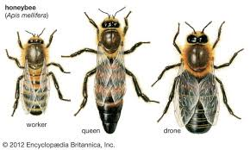
df}/Lsf] hLjgrqm
jo:s (Adult)
;fdfGotof k'mnb]lv jo:s cj:yf;Dd k'Ugsf nflu df}/Lsf] ju{cg';f/ /fgLnfO{ 15-16 lbg, sdL{ df}/LnfO{ 20-21 lbg / efn] df}/LnfO{ 22-24 lbg ;do nfU5 .
df}/L | k'mn | nfef{ | Ko'kf | hDdf
/fgL df}/L | 3 | 5.5 | 7.5 | 16 lbg
sdL{ df}/L | 3 | 6 | 12 | 21 lbg
efn] df}/L | 3 | 6 | 14.5 | 23.5 lbg
/fgL df}/L, sdL{ df}/L / efn] df}/Lsf] zf/Ll/s agf]6 / sfo{ km/s km/s x'G5 .

Slide 17
df}/Lsf] ju{ / pd]/cg';f/ sfo{ ljefhg
J|m=;= | ju{ / pd]/ | sfo{x¿
1 | efn] | /fgL df}/LnfO{ uef{wfg u/fpg] / 3f/nfO{ Gofgf] kfg{ sfo{ u5{ .
2 | /fgL | k'mn kfg]{, z/L/af6 ljleGg lsl;dsf uGwx¿ lgisf;g u/]/ uf]nfsf] ;~rfng / lgoGq0f ug]{ u5{ .
3 | sdL{ 1-3 lbg | of] pd]/sf] sdL{ df}/LnfO{ lzz' df}/L klg elgG5 / logLx¿ lgs} sdhf]/ x'Gf] x'Fbf cfk"m tª\lu|g], lxF8\g l;Sg], rfsfdf 6fFl;P/ c¿ k'mn,nfef{, Ko'kfnfO{ Gofgf] lbg], cfˆgf] jl/kl/ 5l/Psf] vfgf vfg] / cln cln sf]if ;kmf ug]{ sfd u5{g\ .
 | 4-6 lbg | l5lKkPsf nfef{nfO{ dx / s'6 v'jfpF5g\ / cfk"m klg k|z:t vfgf vfG5. .
 | 7-11 lbg | of] pd]/sf sdL{ df}/Lsf] 6fpsfdf lz/u|GyLsf] ljsf; x'G5 . lz/u|GyLaf6 Royel Jelly pTkfbg x'G5 . of] Royal Jelly sdL{ df}/Ln] sd pd]/sf nfef{ / /fgL df}/LnfO{ v'jfpF5 / cfk"m klg k|z:t cfxf/f vfG5 .
 | 12-17 lbg | of] pd]/sf sdL{ df}/Lsf] lz/u|GyL ;'S5 / klxn] vfPsf] k|z:t dxn] ubf{ k]6sf 4 hf]/ d}g u|GyL /;fP/ d}g pTkfbg u5{ . ToxL d}gnfO{ sf]t/]/ sdL{ df}/Ln] rfsf nufpF5, nfef{ / dx sf]ifx¿ aGb u5{ . lognfO{ lgdf{l0fsf klg elgG5 .
 | 18-20 lbg | of] pd]/df sdL{ df}/Lsf] u|GyL ;'S5 . clg ljif u|GyL / lvnsf] ljsf; x'g] xFb' f cfˆgf] 3f/sf] k|j]zåf/df a;]/ 3f/sf] ;'/Iff u5{ .
 | 21 lbgkl5 | o; cj:yfdf k'u]kl5 aNn sdL{ df}/L 3f/ aflx/sf sfd, h:t} Mk'ik/;, k/fu, rf]k, kfgL cflb ;ª\sng ug{sf] nflu v]taf/L / jghª\undf rg{ hfG5 .

Slide 18
Project Work
l6lkP; ljlwaf6 Dff}/L kfngn] ubf{ dfgj hLjgdf x'g] kmfObfx¿sf af/]df ;d"xdf 5nkmn u/fpg], lzIfsn] lgZsif{ k|:t't ug]{

Slide 19
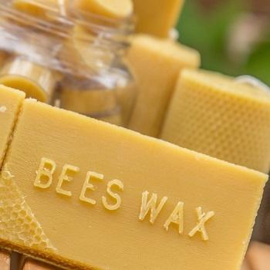
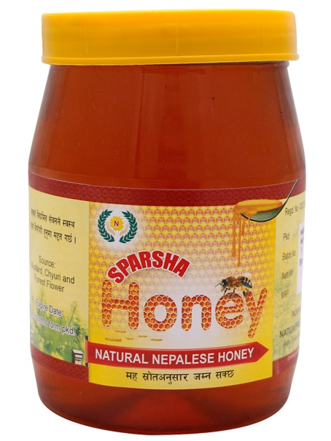
df}/Lsf] pkof]lutf (Uses of honey bee)
!= df}/Ln] ljz]if kf}li6s tTTjo'St j:t' dx agfpF5 . h'g dw'd]x tyf cGo /f]uLx¿sf nflu clt kmfObfhgs x'G5 .
@= dxaf6 ljleGg k|sf/sf SofG8L, s]s tyf /f]6Lx¿ tof/ ul/G5 .
#= sdL{ df}/Lx¿n] d}g (wax) agfpF5g\ / pSt d}g 6\jfOn]6sf] ;fdfg / s:d]l6S; ;fdfgx¿ agfpg k|of]u ul/G5 . To:t} u/L d}gaQL, ;]leङ lqmd, sf]N8 lqmd cflb agfOG5 .
$= df}/Lx¿n] la?jfx¿df k/fu;]rg u/fpg ;xof]u u5{g\ .

Slide 20
Project Work
• s[lif / dfgj hLjgdf df}/Lsf] pkof]lutfsf af/]df lgaGw n]Vg nufpg]

Slide 21
Project Work
• ;Dej eP;Dd df}/Lkfng ul/Psf] If]q e|d0fsf cfwf/df df}/L kfng / o;sf] pkof]lutfsf af/]df 5f]6f] k|ltj]bg tof/ ug{ nufpg] / k|:t't ug{ nufpg] jf If]q e|d0f ;Dej gePsf] v08df cgnfOg ckmnfOg vf]h u/L ;f] sfo{ k"/f ug{ nufpg]

Slide 22
Any Queries ???

