Slide 1

Welcome dear students

Slide 2
Class: 10
Subject: Science and Technology
Unit: 7 Motion and Force
Teacher: Lokendra Subedi
School: Shree Amar Jyoti SS surkhet
Email: lokendrasubedi42@gmail.com
contact: 9848078333

Slide 3
Dear students, after the completion of this unit, you must be able to
State Newton’s law of gravitation and solve simple mathematical problems related to it
Define acceleration due to gravity and express the relation of acceleration due to gravity to the radius of the Earth
Introduce gravity and calculate the weight of an object
Clarify the concept of free fall
Explain the role of atmosphere on falling object and its application

Slide 4
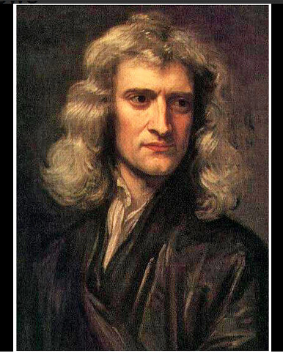
Know him

Slide 5
Geocentric Vs Heliocentric Theory
Geocentric Theory
Before 16th century, it was believed that the Earth remains at the centre of the Universe and all other celestial body go around it
Heliocentric Theory
After 16th century, people around the world started to believe that The Sun remains at the centre and planets and satellites go around it.

Slide 6
Essential question: Have you ever thought what would be the reason that the Earth always revolves around the Sun keeping equidistant.
The external agency that changes or tends to change the state of a body is called force.
Force are of many types: Frictional, Mechanical …………..
Out of many one is gravitational force or simply gravitation
Gravitation is defined as the mutual force of attraction between any two objects of this Universe because of their masses which attracts them to each other.

Slide 7
e.g. bet^{n} The Earth and the Moon, there is presence a force of attraction which attracts both Earth and Moon to each other. It is known as the gravitation (force of attraction) bet^{n} the Earth and the Moon.
This force is Universal.
Laws of gravitation
Newton’s universal law of gravitation states that:
The force of attraction bet^{n} any two objects in this universe is
Directly proportional to the product of their masses
Indirectly (inversely) proportional to the square distance bet^{n} them

Slide 8


Mathematically,
F ∝ M₁ x M₂
F ∝ 1/d²
F ∝
F =
Where, G is universal gravitational constant. Its value is 6.67 x 10⁻¹¹ Nm²Kg⁻² (Nm²/Kg²) watch plz: http://www.youtube.com/watch?v=c9shwPMpSq8
M₁
d
M₂
A
B

Slide 9
Students, answer these questions
• What happens to force of attraction when the distance between two bodies is halved ?
• What factors affect the force of attraction between two objects. Name any three factors. And also write how these factors affect?

Slide 10

Calculate the value of G if two bodies are of unit masses and they are apart unit distance.
Formula,
F =
F =
F = G
Now, try to define G.

Slide 11
Universal gravitational constant G can be defined as the force of attraction between two bodies of unit masses separated by unit distance.

Slide 12
Numerical Problem:
The mass of The Earth is 6 x 10²⁴ Kg and that of Jupiter is 1.91 x 10²⁷ Kg. Distance between them is 9.68 x 10⁸ Km. Calculate the the force of attraction between them. ( G = 6.67 x 10 ⁻¹¹ Nm²/Kg² )

Slide 13

Given,
M₁ = 6 x 10²⁴ Kg
M₂ = 1.91 x 10²⁷ Kg
d = 9.68 x 10⁸ Km = 9.68 x 10⁸ x 1000 m =9.68 x 10¹¹ m
F = ?
F =
=

Slide 14
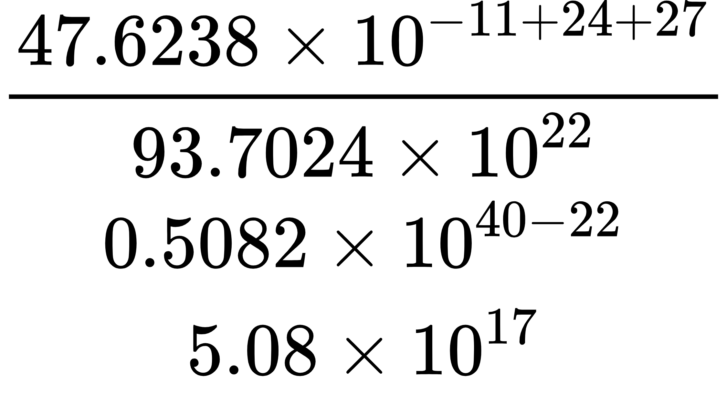
=
=
= N

Slide 15
Consequences or effects of Gravitation
Planets revolve around the sun and satellites revolve around the planets
Tides occurs in the seas or oceans.

Slide 16
What happens when out of two bodies, one is massive and another is minute.e.g. One body is Earth and another body is stone thrown by us in the sky

Slide 17
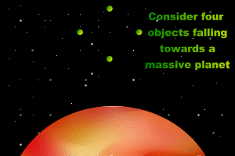

Slide 18
Obviously stone falls on the ground.
Why such happens?
Why the Earth and the Stone do not remain apart equidistantly?
Why the Earth does not seem to fall towards the stone.

Slide 19
If there are two bodies one is massive like planets, satellites, stars and another very minute lying near or on the surface of the massive body
According to gravitation, there must be force of attraction between them which attracts to each other.
This happens but we can feel only force of attraction on minute body not on massive body.

Slide 20
This is because of massive mass of one comparable to another.
Such type of force of attraction between two bodies ( one celestial and another object on its surface) is called force of gravity or simply gravity only.
We might say like this: gravity of the Earth, gravity of the Moon etc
But we do not say gravitation of the Earth, instead, gravitation between the Earth and the Moon.
Gravity is no other than gravitation instead it is special case only. Now state what is that special case? Write now.

Slide 21
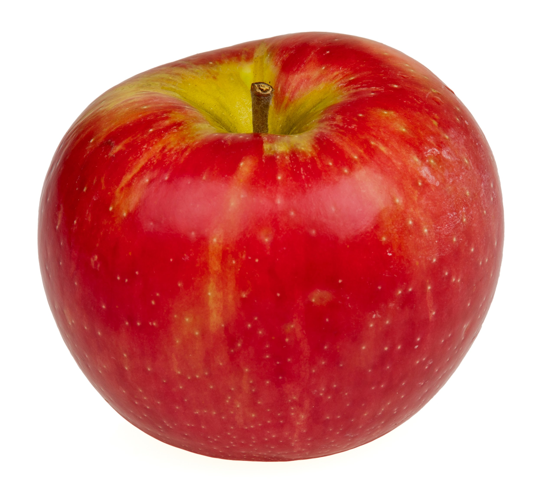

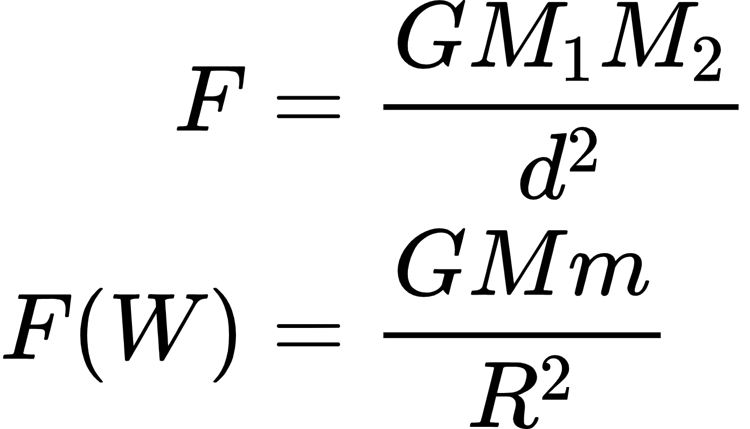
According to law of gravitation
Where, W = force of gravity, G = gravitational
Constant, M = mass of celestial body, m = mass
Of object and R = radius of celestial body
m
d=R
M

Slide 22
Effects of gravity
The gravity of the Earth holds the atmosphere around it
Fall of rain, snow is possible
Every objects feels weight
Objects thrown in the sky fall on the ground
Flowing of rivers, blowing of wind, stability of buildings, bridges are possible

Slide 23
Weight
Weight of an object means the force of gravity applying on it by celestial body towards its centre.
Weight of yudika in the Earth means the gravity exerted by Earth on yudika to pull her towards its centre.
Weight of pangali in the moon means the gravity exerted by Moon on pangali to pull him towards its centre.

Slide 24
Weight and gravity are same. We should say like weight of yudika, weight of pangali similarly gravity of the Earth on yudika, gravity of the Moon on pangali
But……….
Never say gravity of yudika, gravity of pangali, weight of Earth and weight of the Moon.
How many factors are there which causes the difference of weight of a body or gravity applying on it? And how do they affect?

Slide 25
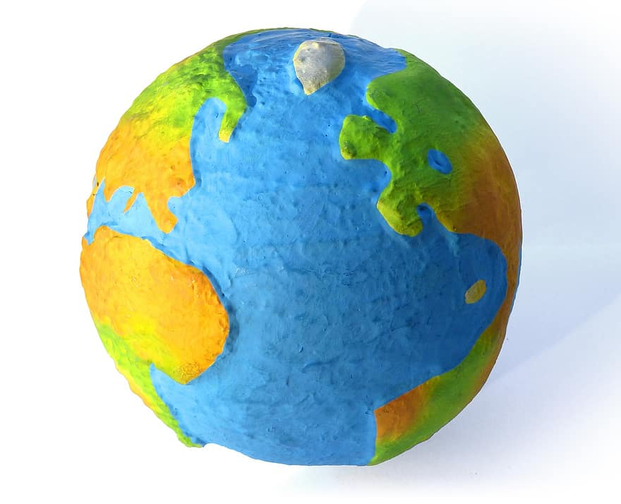
What you observe in the Earth about its radius since the Earth looks like an orange not perfect sphere.

Slide 26
Variation of force of gravity on the Earth due to its orange shape
The force of gravity is more at pole than at equator. Can you justify

Slide 27
Variation of force of gravity on the Earth surface due to variation of height
The force of gravity is less at top of the mountain than at the bottom. Think and write the reason.

Slide 28
When a body is dropped from a height, it falls slowly first then it starts to fall quickly. As the times passes, its velocity goes on increasing. Why does this happen? What causes it? …………..
There is a force which attracts body towards the surface and we know
This force is gravity
According to Newton’s second law of motion, as the force applies, it creates change in velocity in every second we call it acceleration.
When force is gravity, acceleration is called acceleration due to gravity.

Slide 29

So acceleration due to gravity can be defined as the rate of change (change in every second) of velocity of a freely falling body under the influence of force of gravity. We know, Weight or gravity
(F or W =mg)

Slide 30

For a given celestial body (suppose the Earth), M ( mass of heavenly body ) is constant. G is always constant. That’s why,
What conclusion do you draw from above relation. Please! Write.

Slide 31
On which factors does the acceleration due to gravity depend? How do they depend? Formula is g = GM/R²

Slide 32
Variation of g on the Earth surface
Earth is not a perfect sphere, it is flattened at the pole and bulges out at the equator. Radius of the Earth is greater at equator and lesser at pole.
acceleration due to gravity g is inversely proportional to the square radius, value of g is greater at pole and less at equator.
Being height at the high altitude, distance from the centre of the Earth (i.e. radius) increases as a result, g decreases

Slide 33
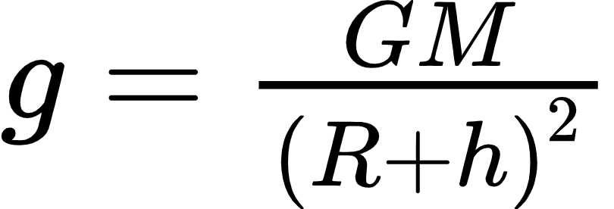
Acceleration due to gravity at height ,
Value of g at pole = 9.83 m/s²
Value of g at equator = 9.78 m/s²
Average Value of g at Earth surface = 9.8 m/s²
Value of g on Moon = 1.67 m/s²
Value of g on jupiter = 25 m/s²

Slide 34
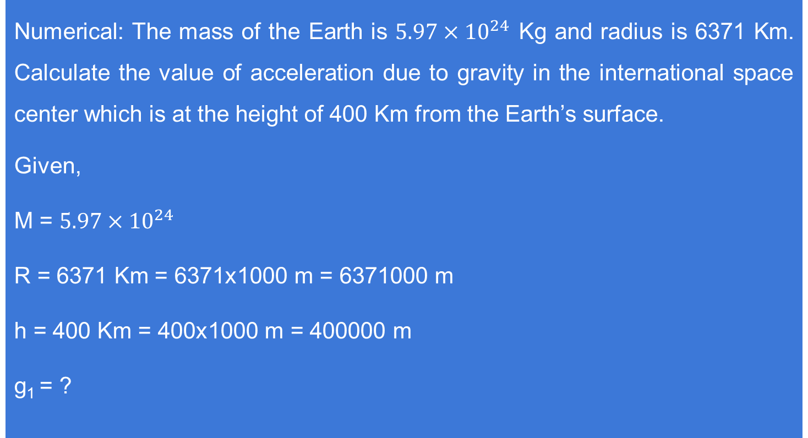
Numerical: The mass of the Earth is $5.97×{10}^{24}$ Kg and radius is 6371 Km. Calculate the value of acceleration due to gravity in the international space center which is at the height of 400 Km from the Earth’s surface.
Given,
M = $5.97×{10}^{24}$
R = 6371 Km = 6371x1000 m = 6371000 m
h = 400 Km = 400x1000 m = 400000 m
g₁ = ?

Slide 35
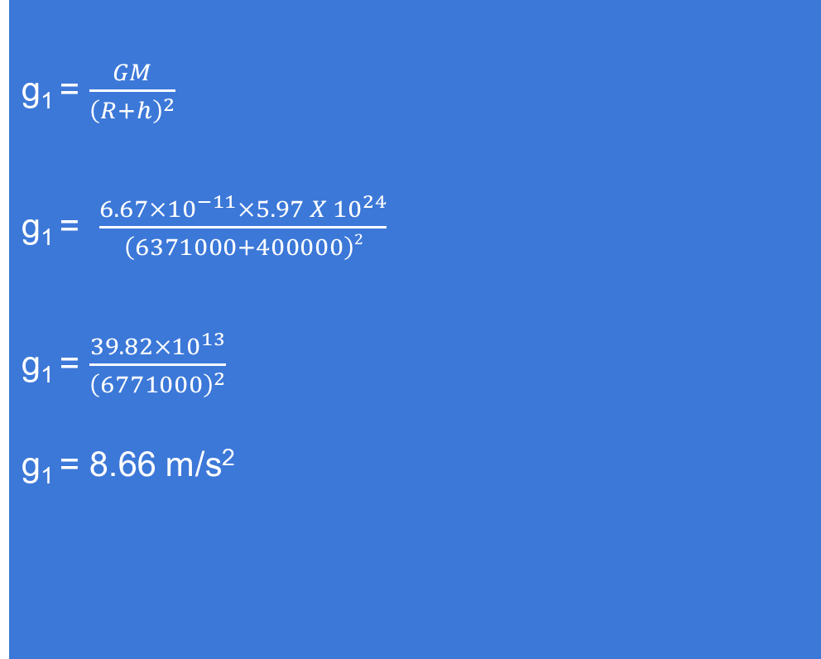
g₁ = $\frac{GM}{{\left(R+h\right)}^{2}}$
g₁ = $\frac{{6.67×10}^{−11}×{5.97 X 10}^{24}}{\left(6371000+400000\right)2}$
g₁ = $\frac{{39.82×10}^{13}}{{\left(6771000\right)}^{2}}$
g₁ = 8.66 m/s²

Slide 36
What do you think if two objects one very large and another very small fall at once from a same height towards the Earth where there is no any resistance, which fall at first on the surface?

Slide 37
Freefall and weightlessness
When a boby is falling towards the centre of the Earth in the absence of any external resistance (air) , it falls at the rate of acceleration due to gravity. This type of falling is known as freefall.
During freefall the body does not experience any sort of pulling force on it (weight) and feels ‘0’ weight or weightless, this condition of being zero weight is known as weightlessness. Plz watch: https://www.youtube.com/watch?v=zy1Bb6Pp95s

Slide 38
Coin and feather experiment
Watch this video carefully and write the conclusions you can draw from it.
https://www.youtube.com/watch?v=Cxzo_Ct3Yf8&ab_channel=eASYtIPS4YOU

Slide 39
In moon there is absence of atmosphere but present in the Earth. If a coin and feather is dropped from a certain height simultaneously once in moon and another in the Earth what difference will you observe in falling in both heavenly bodies? Write your answer.

Slide 40
Falling with a parachute in the moon from a certain height is dangerous. But safe in the Earth, how ? justify.

Slide 41
Mass vs weight
mass | weight
Mass is total amount of matter or substance contained on a boby Unit is Kg Constant in everywhere Measured by physical or beam balance Scalar quantity | Weight is the amount of force of gravity on a body Unit is N Variable Measured by spring balance Vector quantity

